Slide 1
Advanced Modularization, Aspects, and Their Application in Software Product Lines
Aspects around us

Slide 2

Ing. Jakub Perdek About the author
https://jakubperdek-26e24f.gitlab.io/
I am a doctorand focused on reuse in the area of software product lines at the Institute of Informatics,
Information Systems and Software Engineering, Faculty of Informatics and Information Technologies,
Slovak University of Technology in Bratislava.
I have membership in AdvanSD research group.
Research Fields
  Software product lines (dissertation): Annotation based, Aspect oriented, and model driven.
  Information retrieval (master thesis): Similarity metrics, LDA, indexing, BIG Data (Hadoop, PIG, Hive), etc.
  Machine and Deep learning (bachelor thesis): Their application.
  Data structures and algorithms: Experimenting with algorithms applied to different technologies.
  Computer Graphics (side): Its use in Web development.

Slide 3
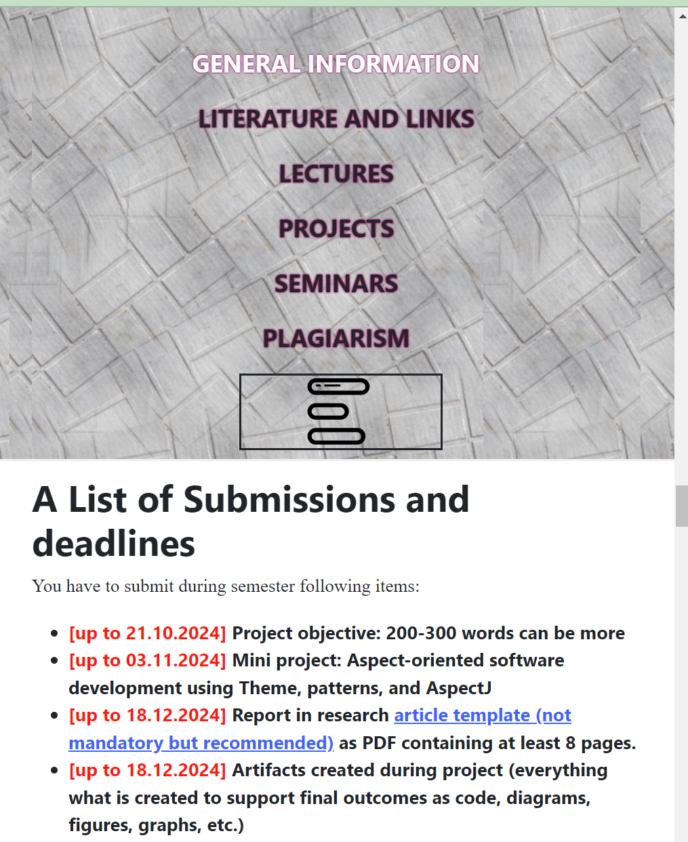
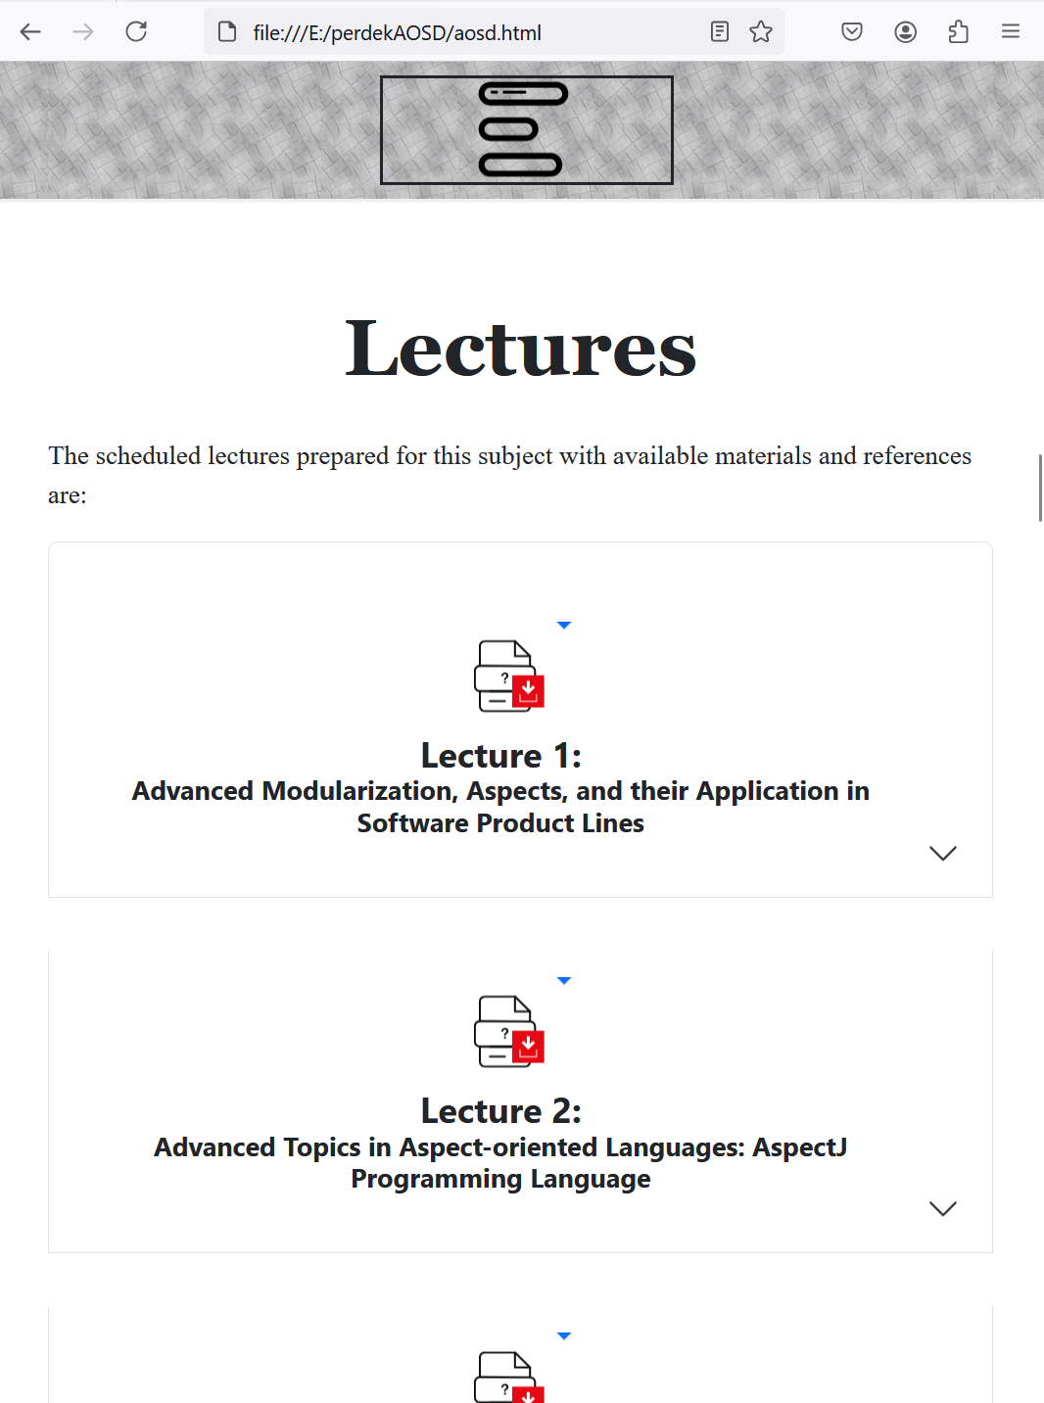
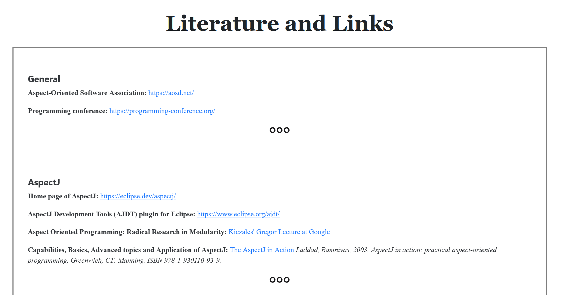
Web Page of the subject
https://jakubperdek-26e24f.gitlab.io/aosd.html

Slide 4
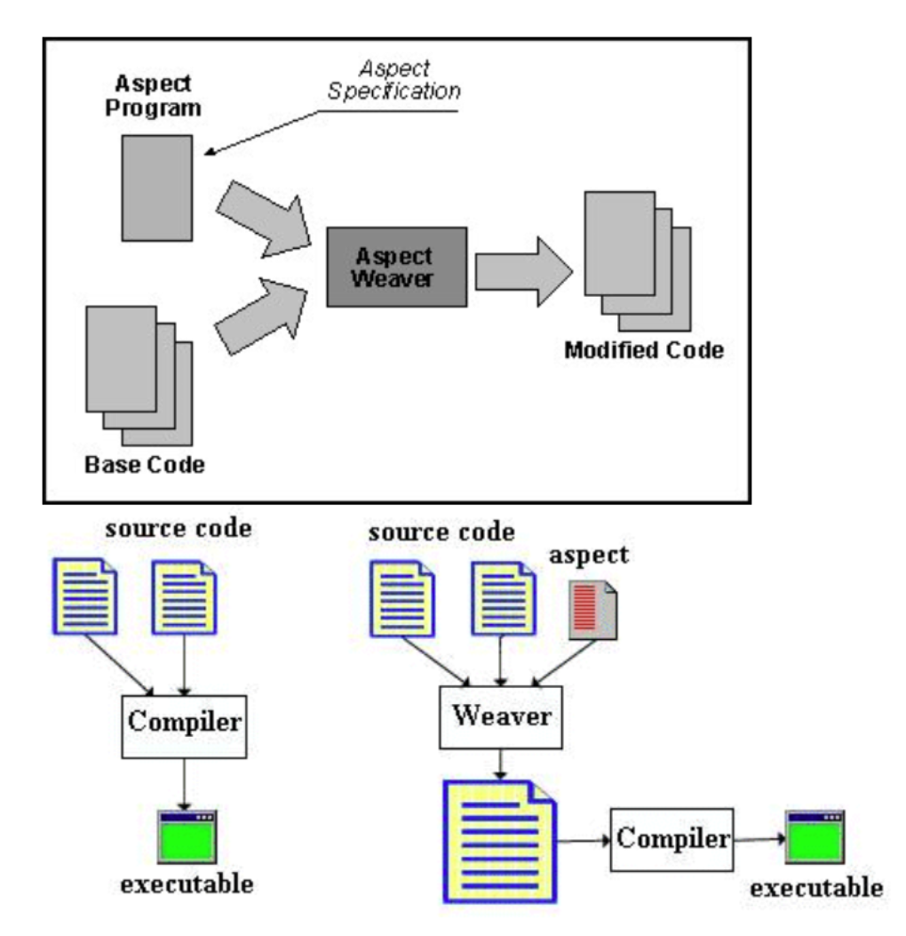
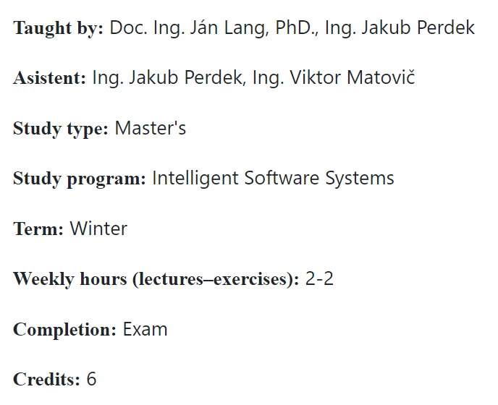
Aspect-Oriented Software Developement
Source: https://sites.google.com/site/sites/system/errors/
WebspaceNotFound?path=%2Fjavatouch%2Fintroductiontoaop

Slide 5
What it will about?
Aspect-oriented programming
  Its features in various languages (Java, JavaScript/TypeScript, C, C++, Python, DSL (domain-specific languages), …)
  Implications to use-cases
  Its use across the whole development cycle (analysis, design, implementation, testing, maintenance)
  Benefits and drawbacks of aspect-oriented programming
  Its use in advanced modularization + cases
  Its use in software product lines as complex systems
Advanced modularization
Software product lines as complex systems
Variability handling (in annotation based software product lines)
  How to evolve variable features independently using aspects

Slide 6
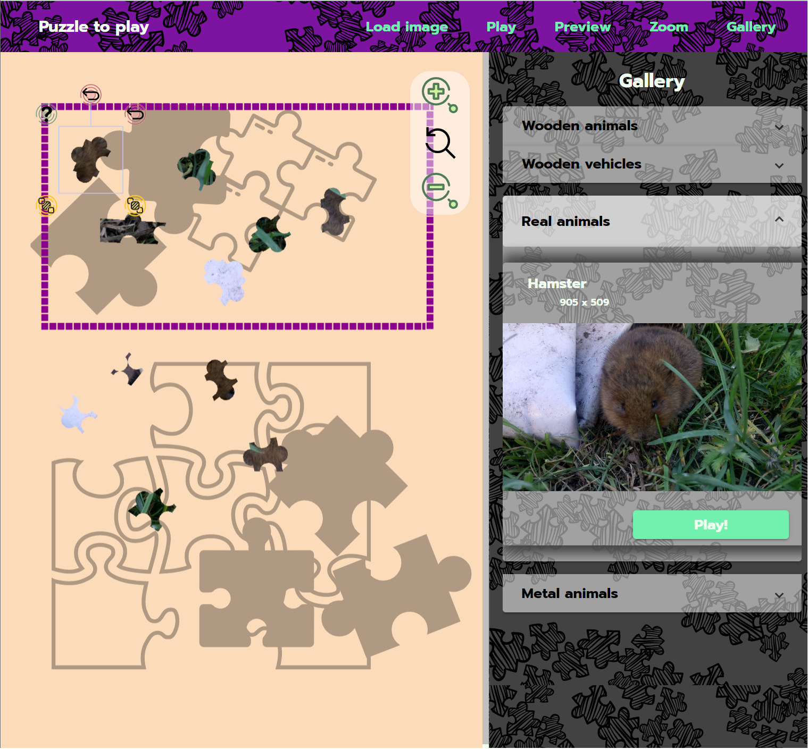
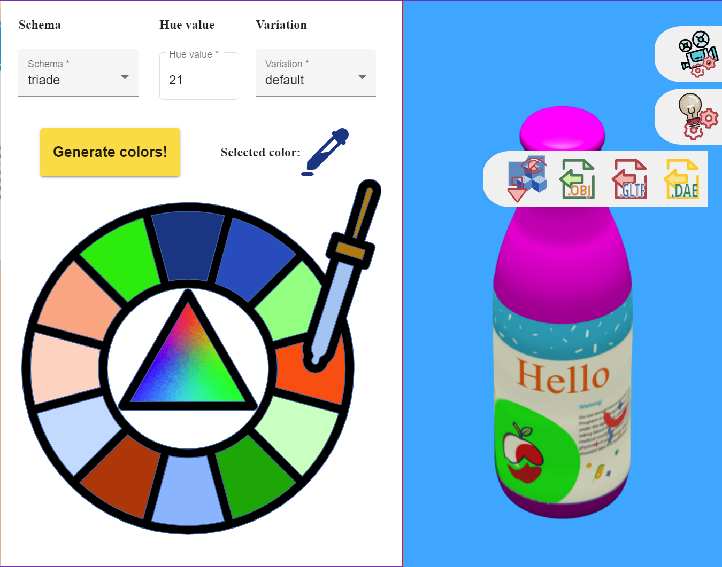
Software product lines
NO ASPECTS
IN PRODUCTS

Slide 7
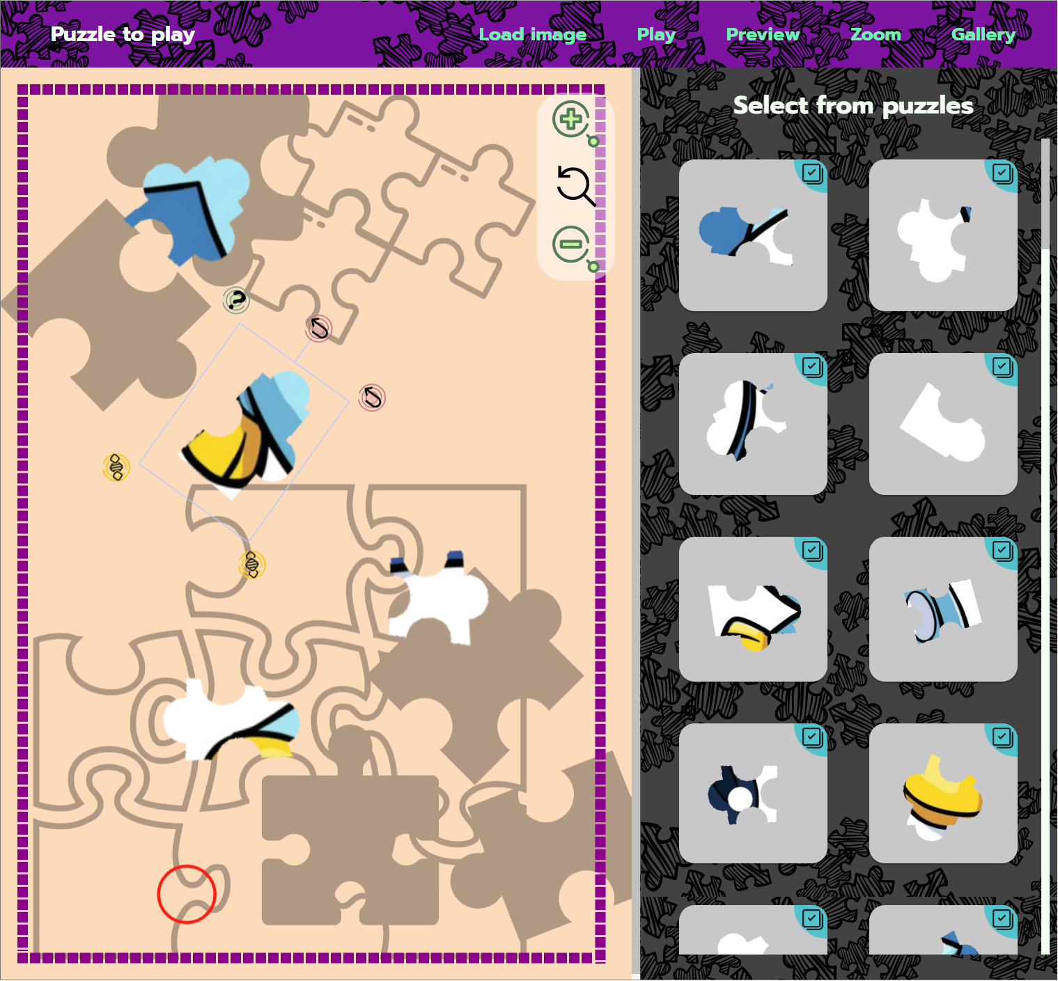
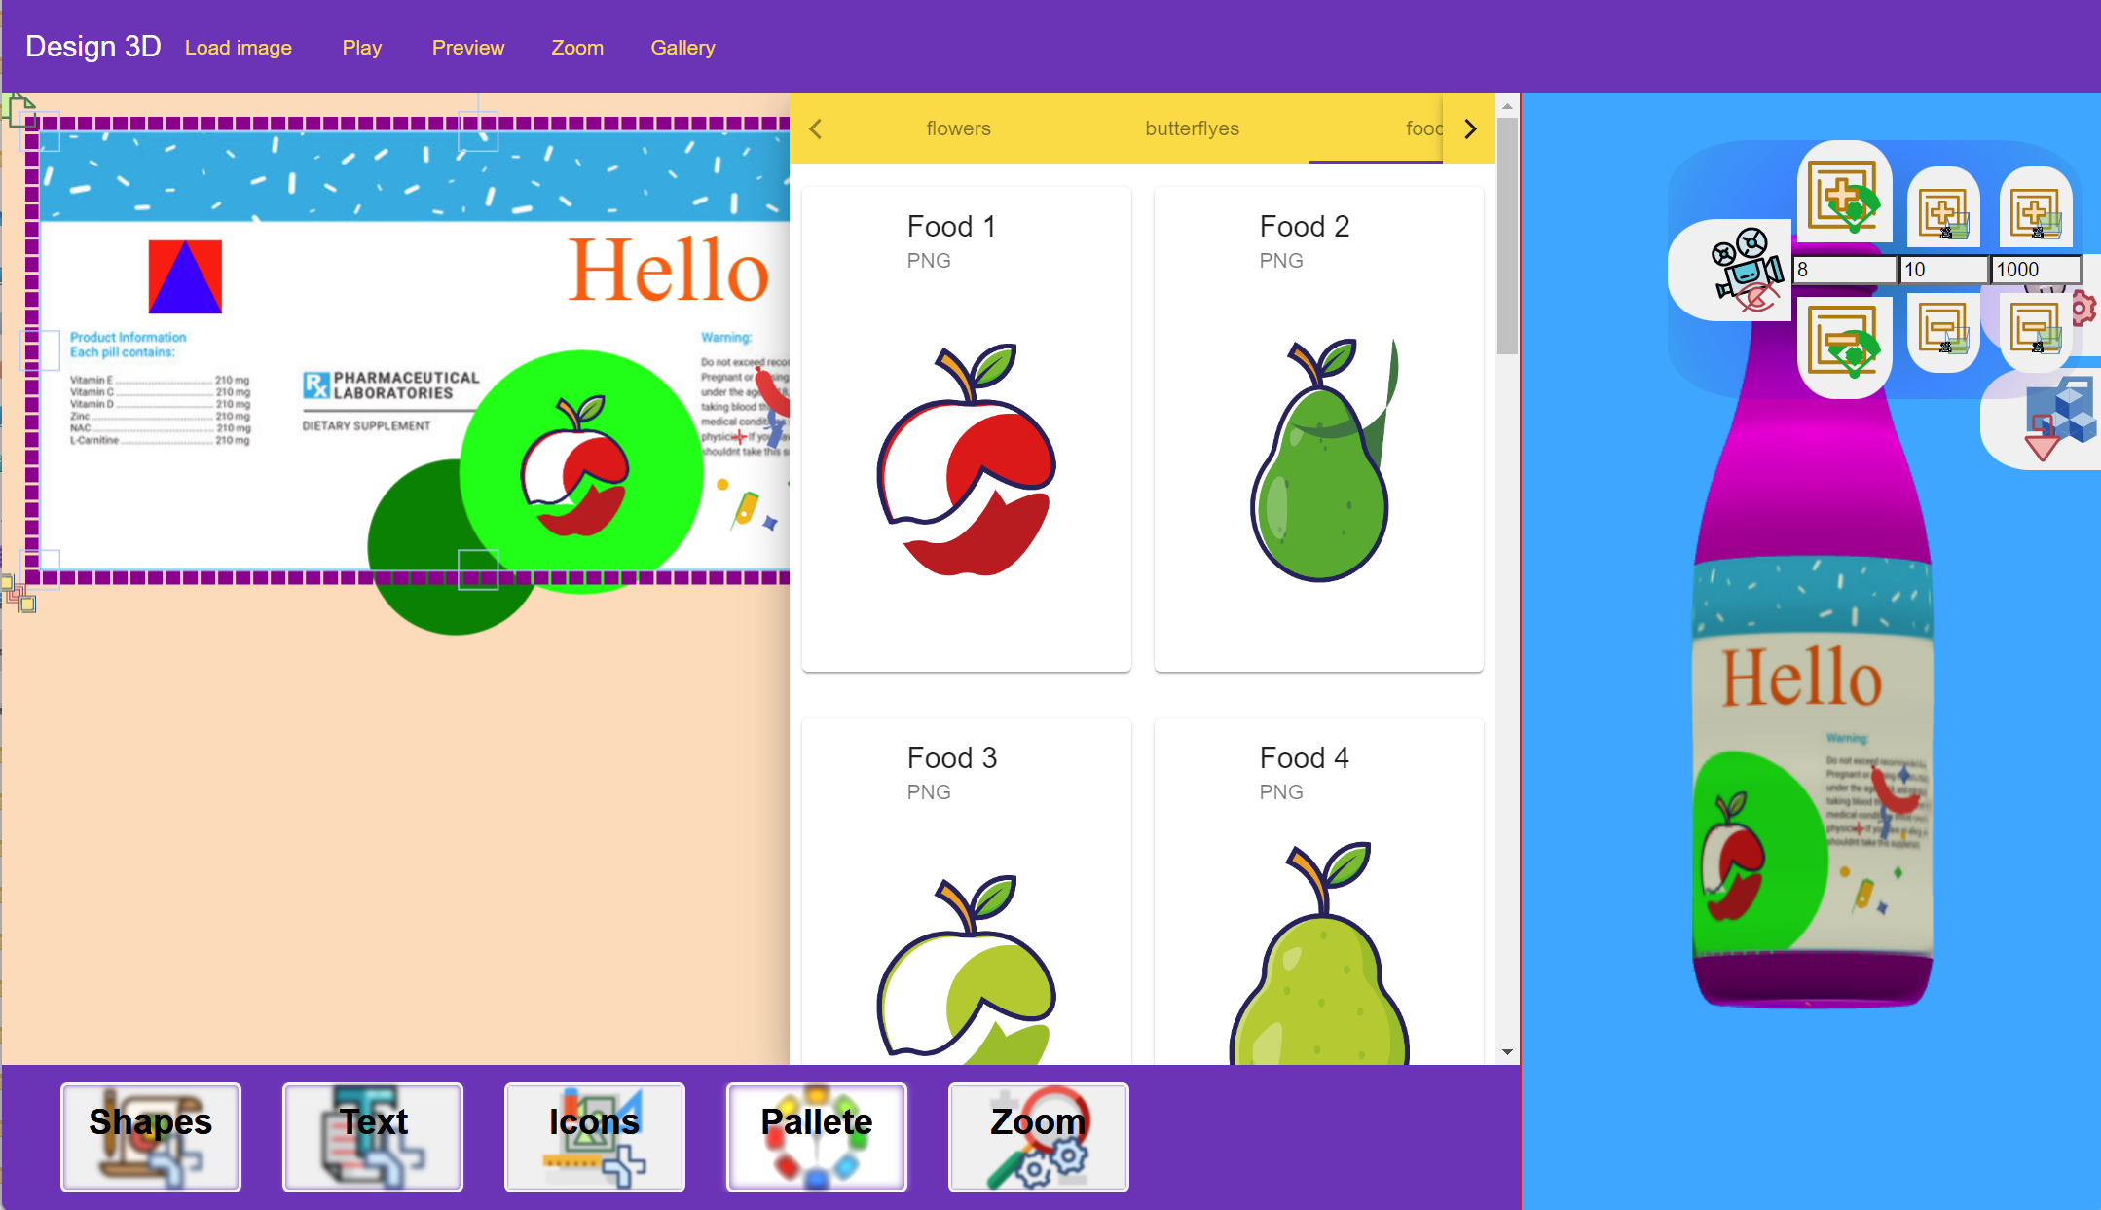
Commonality
vs. Variability
Puzzle app.
vs.
Desing app.

Slide 8
Previous page of the course
http://www2.fiit.stuba.sk/~vranic/aosd/index.html

Slide 9
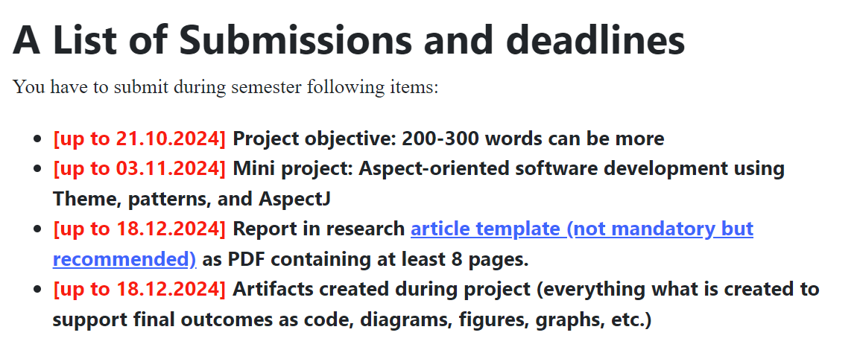
Projects

Slide 10
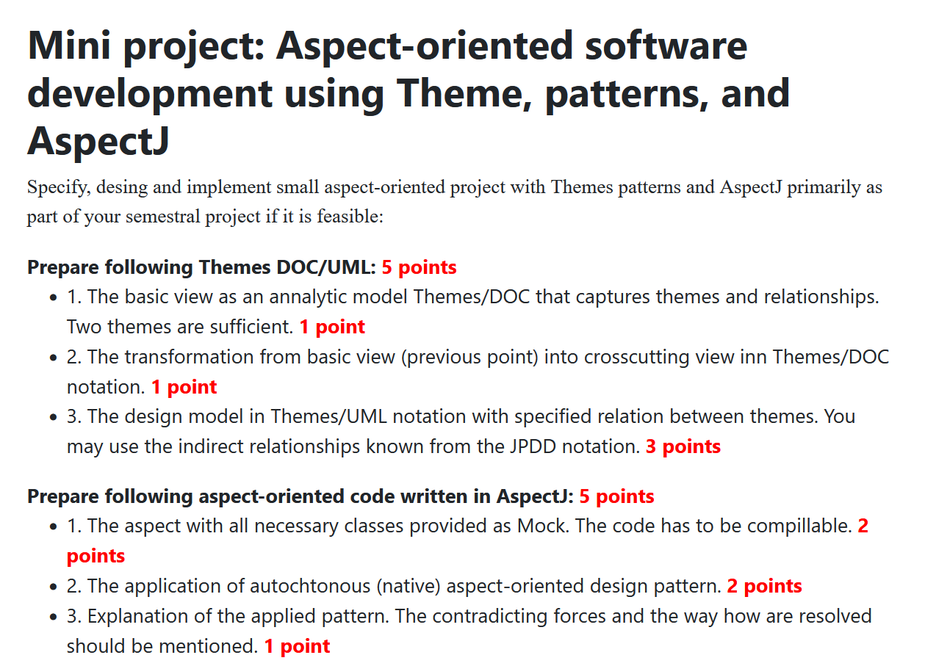
Mini
Project

Slide 11
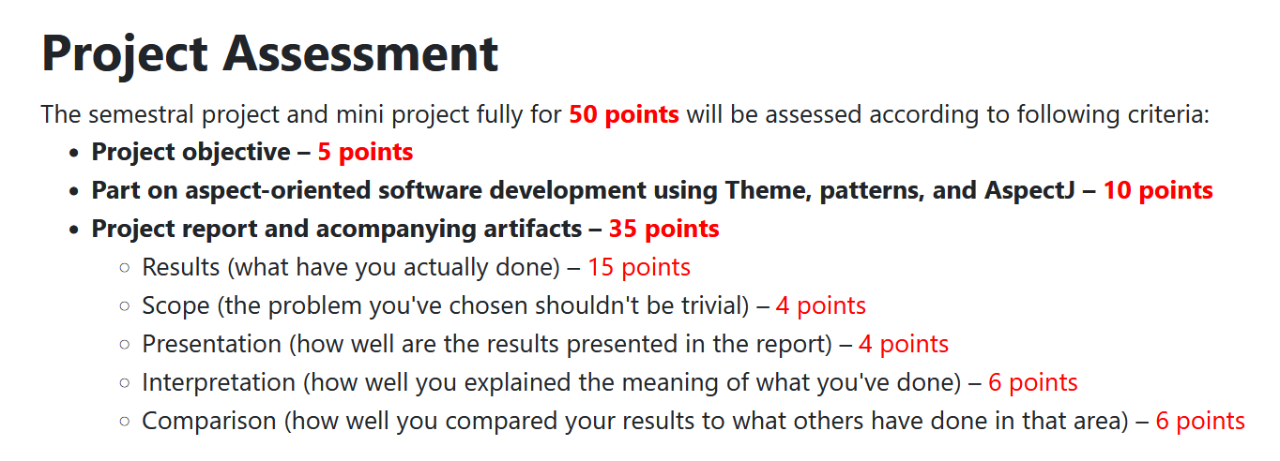
Project Assessment

Slide 12
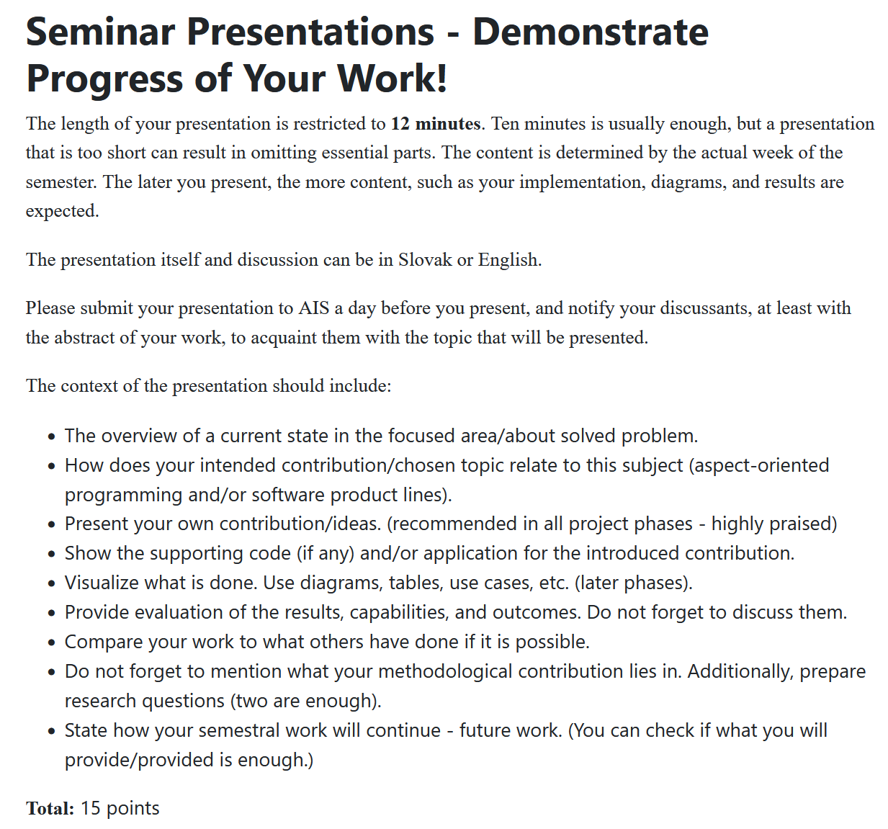

Slide 13
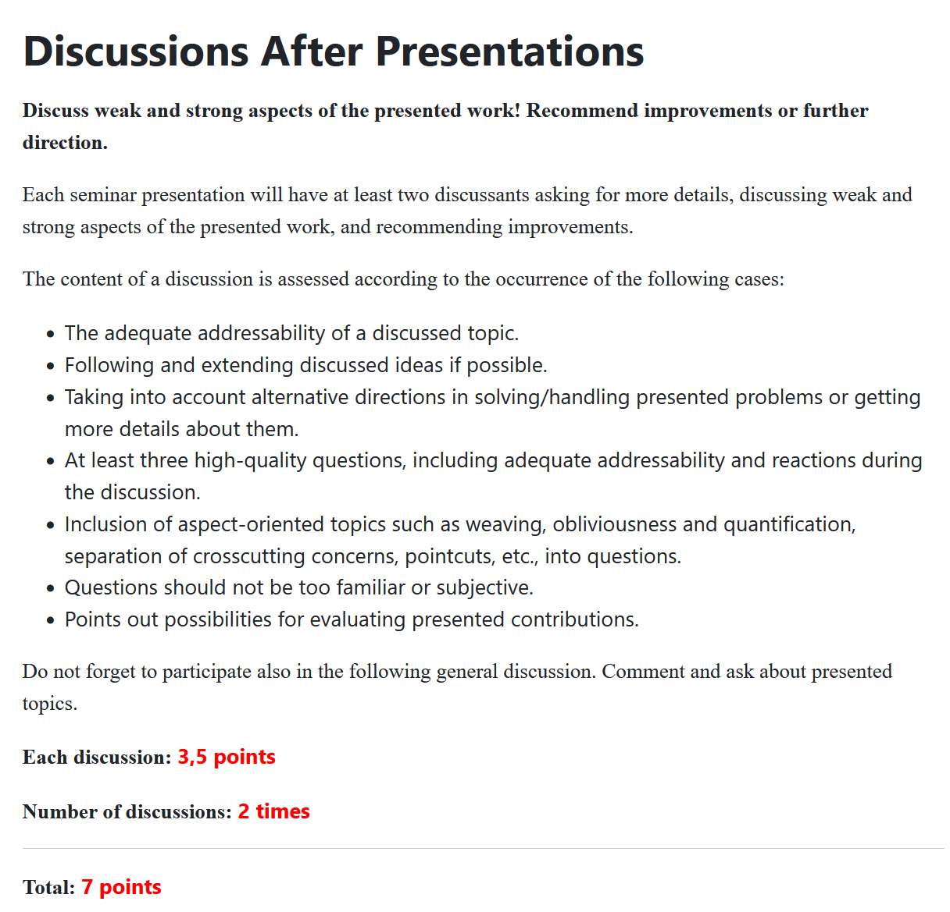
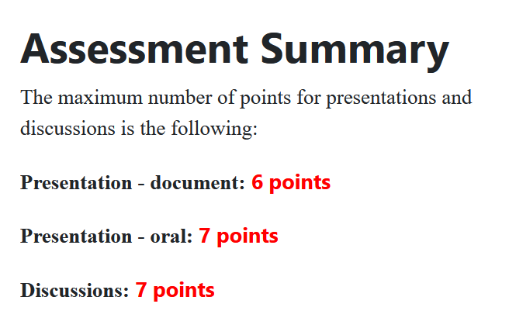
Presentation
Discussion

Slide 14
Overall Assessment
Projects - 50 points (project objective + semestral project + mini project)
Seminars - 20 points (discussions and presentation)
Final exam - 30 points
        100 points

Slide 15
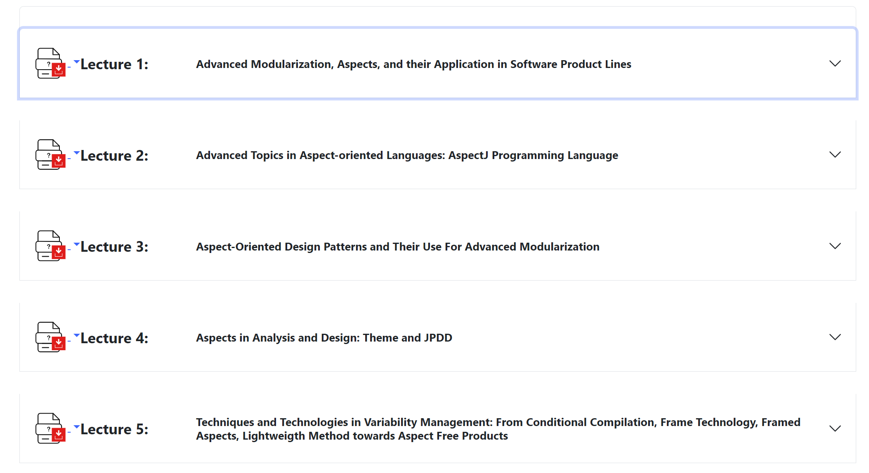

Slide 16
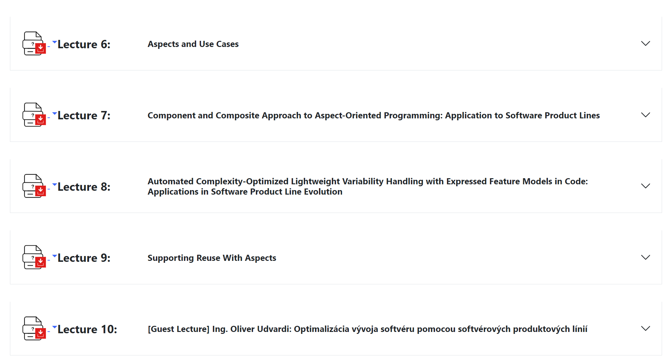

Slide 17
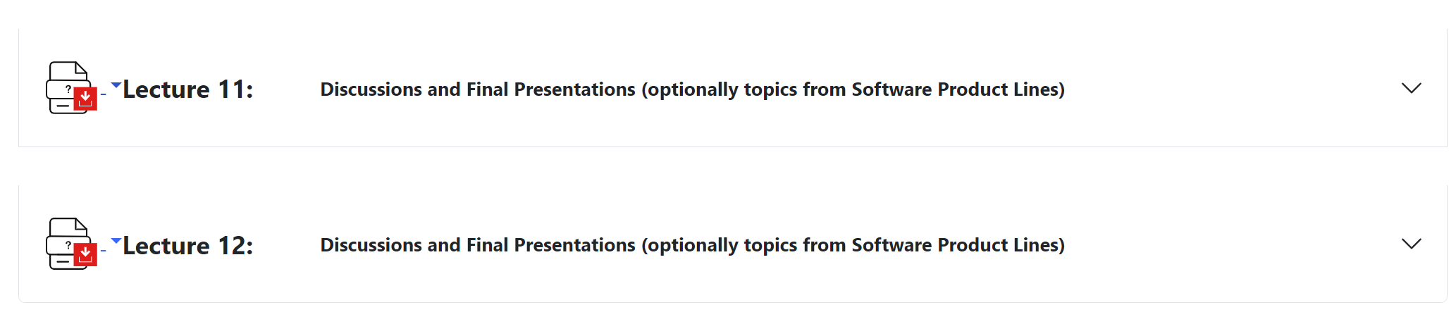

Slide 18
Plagiarism
Taking each other's work, which is not yours as your own, is known as plagiarism. It's a forbidden practice. Cases, where such practices are detected will be sent for further investigation and resolution by a disciplinary commission according to valid rules. These rules apply in this subject and disciplinary process.
Resolving Plagiarism Cases In This Subject
Cheating on tests:
Disqualification from the test and assigning zero points.
Cheating on exams:
Disqualification from the exam and granting FX from the whole subject.
The parts of unreferenced work in the project which are not authors‘:
Rejection of submitted project and granting FX if elaboration of the project is
mandatory from the whole subject. Plagiarism is not tolerated in any range.
Disciplinary Commision
Disciplinary violation will include the participation of the dean of faculty in its negotiations and
resolution with a disciplinary commision of this faculty. The disciplinary commission then optionally in accordance
with taken conclusions, gives recommendations to the dean to:
  give a guilty student a rebuke
  conditionally disqualify a guilty student from the faculty
  disqualify a guilty student from the faculty

Slide 19
Plagiarism Prevention / Guidelines
Guidelines such as UC Davis demonstrate actions and practices to get around plagiarism. The most important of them are:
  Work continuosly and independently.
  Check your work after some time (two days or a week) and improve formulations.
  Do not use ChatGPT or any artificial intelligence for paraphrasing.
  Take brief notes from other materials along with used sources.
  Reference paraphrased work with reference in each sentence where it is used. Reference others' work correctly in a way that is recognizable from yours (references at the end of the block probably do not conform to this).
  Share information about your work to such an extent that some details will not be provided. For example, talk about code but not show all its fragments or provide the whole project to others.
  Do not apply minor/cosmetic changes to other's work (replacing words with their synonyms, changing the order of sentences, etc.) or give credit to it if the work is the same in substantial aspects as yours.
  Do not cheat and respond to others on tests, except to the personnel from the subject

Slide 20
Advanced Modularization, Aspects, and Their Application in Software Product Lines
Aspects around us

Slide 21
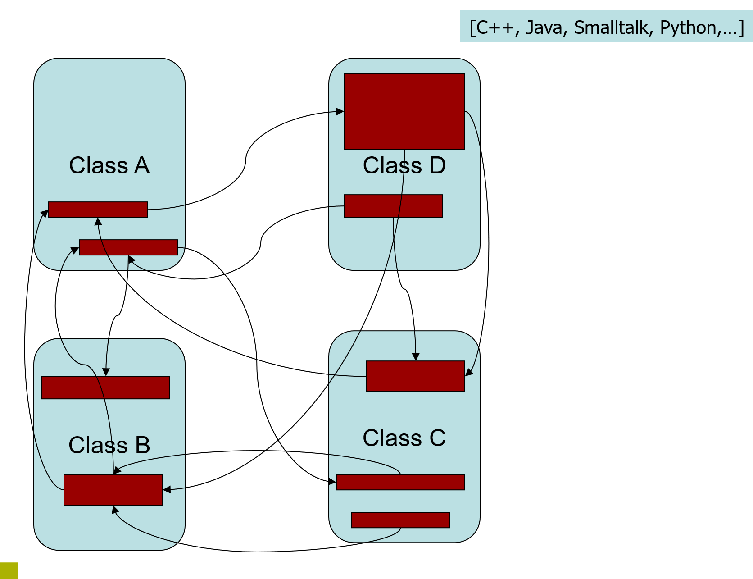
What is the
main problem?
REUSABILITY
Source: http://ssel.vub.ac.be/jasco/lib/exe/fetchb6e2.php
?cache=cache&media=documentation%3Ajasco-vub-session1.ppt

Slide 22
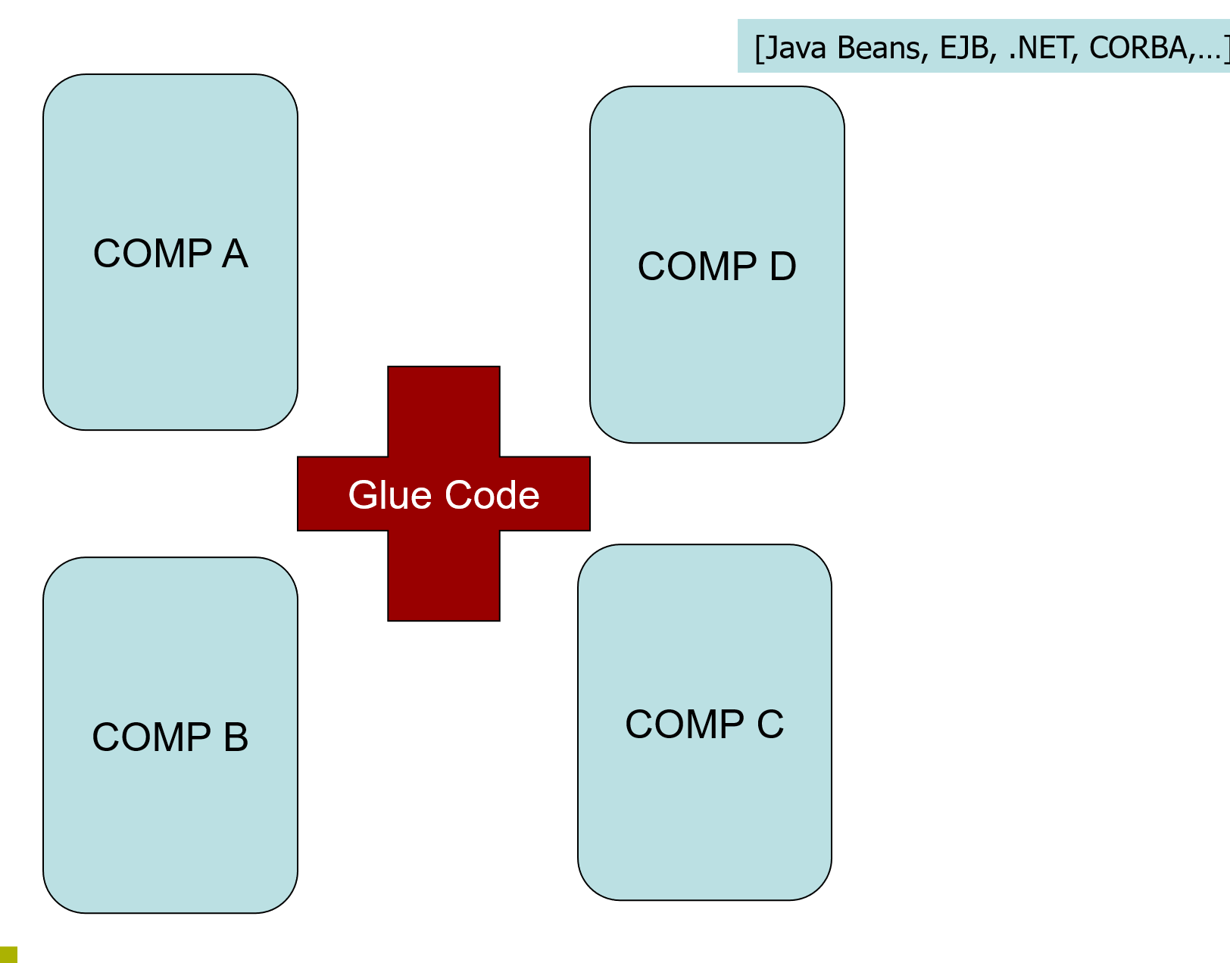
Source: http://ssel.vub.ac.be/jasco/lib/exe/fetchb6e2.php
?cache=cache&media=documentation%3Ajasco-vub-session1.ppt

Slide 23
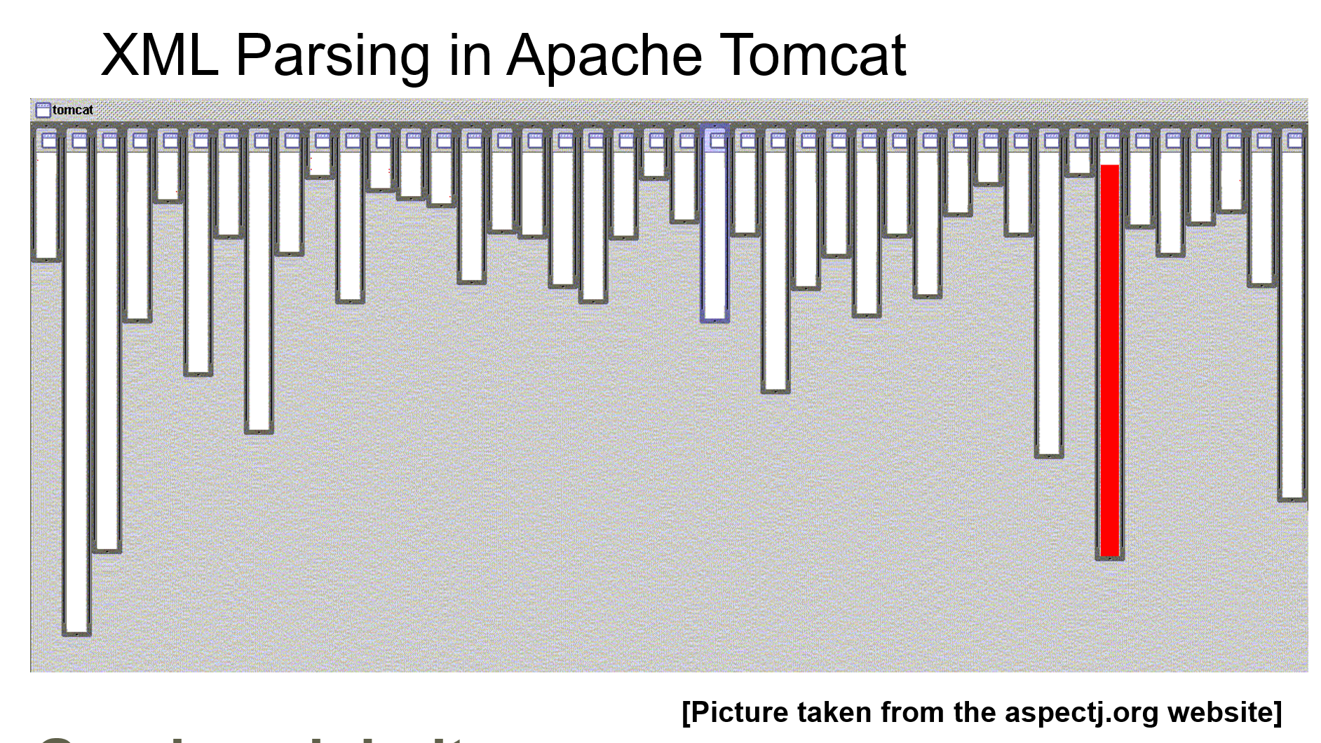
Good Modularity
Source: http://ssel.vub.ac.be/jasco/lib/exe/fetchb6e2.php
?cache=cache&media=documentation%3Ajasco-vub-session1.ppt

Slide 24
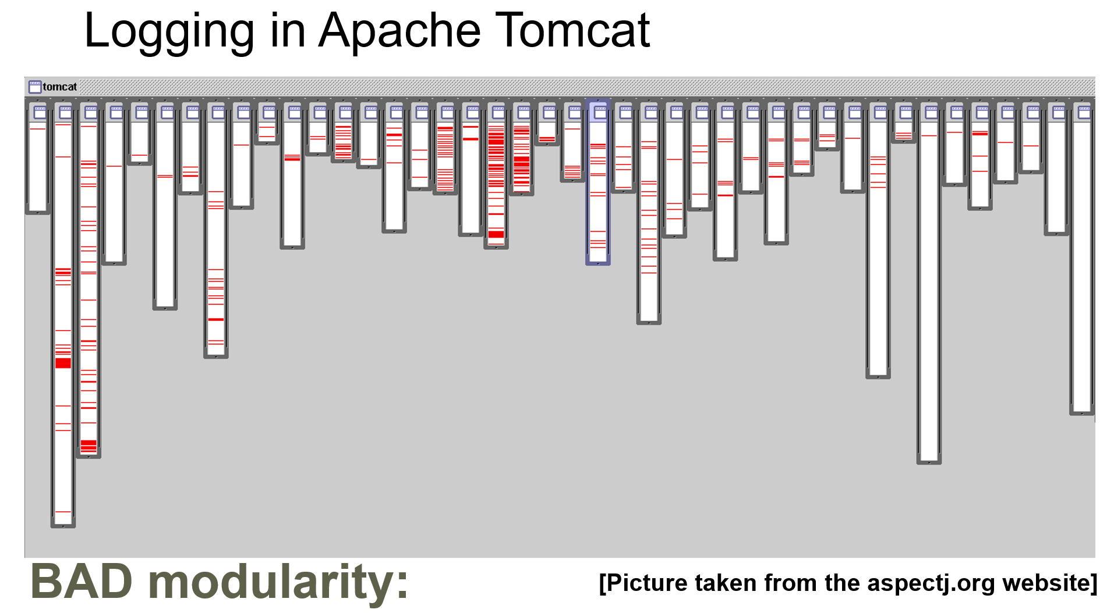
Bad modularity
Source: http://ssel.vub.ac.be/jasco/lib/exe/fetchb6e2.php
?cache=cache&media=documentation%3Ajasco-vub-session1.ppt

Slide 25
How to separate concerns?
-using design patterns
-using component development,
encapsulating functionality
and providing it through interfaces
-using architectural patterns

Slide 26
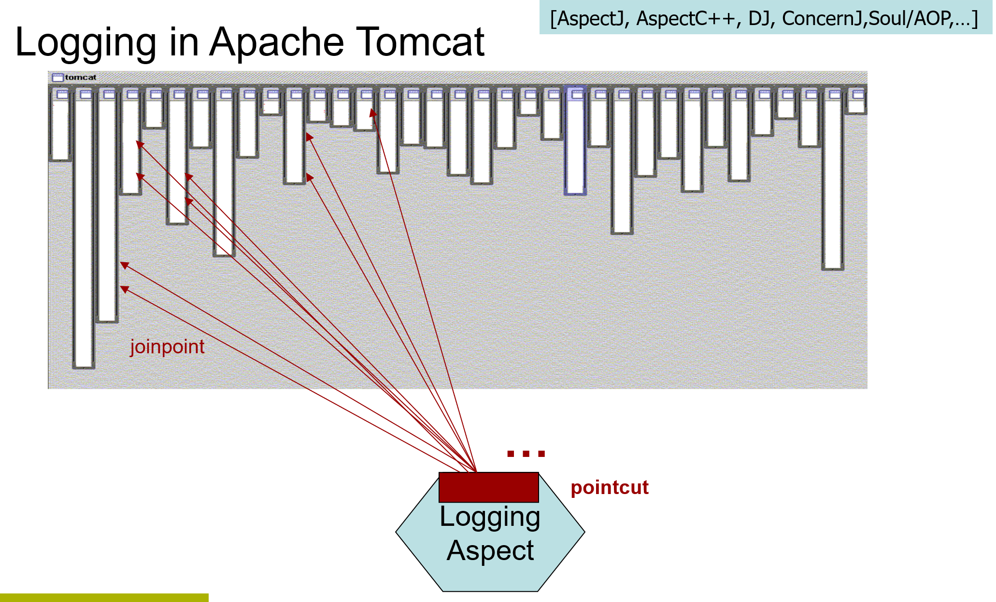
Use of AOP
Source: http://ssel.vub.ac.be/jasco/lib/exe/fetchb6e2.php
?cache=cache&media=documentation%3Ajasco-vub-session1.ppt

Slide 27
How to separate crosscutting concerns?
New concern is not tangled
with original code
Original code should remain untouched
Open-Closed principle
One of SOLID principles
For extensions
For changes

Slide 28
Injecting content to particular places after development.
At compilation-time
At load-time
At run-time
Aspects-oriented paradigm
Weaving functionality of crosscutting concerns
that are preserved in modular way in
standalone files called aspects into original code.

Slide 29
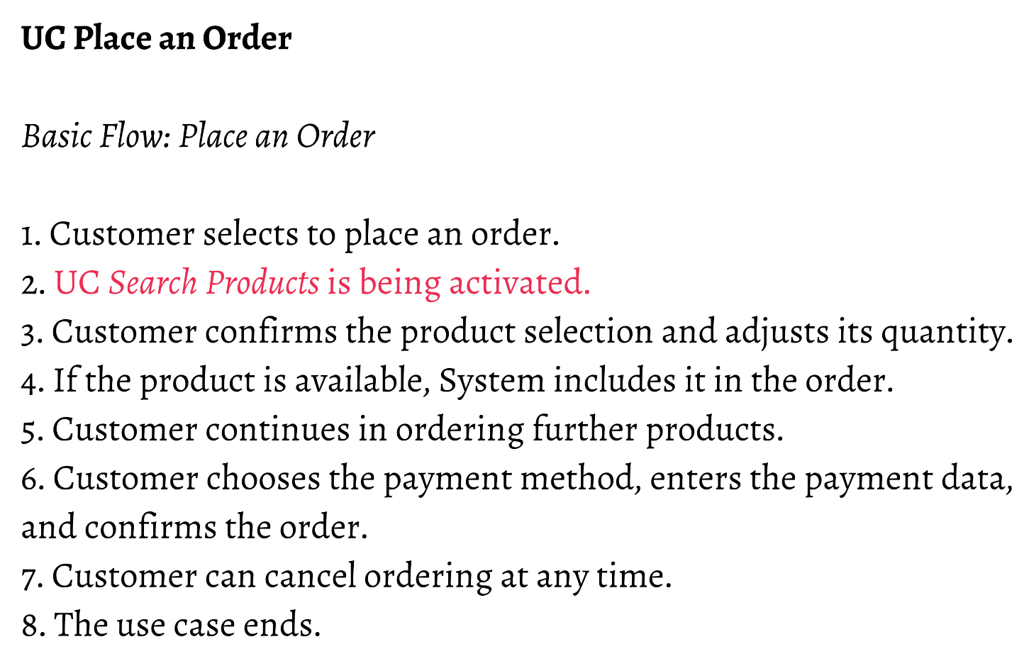
Similar analogy with use cases?
Example taken from: http://www2.fiit.stuba.sk/~vranic/

Slide 30
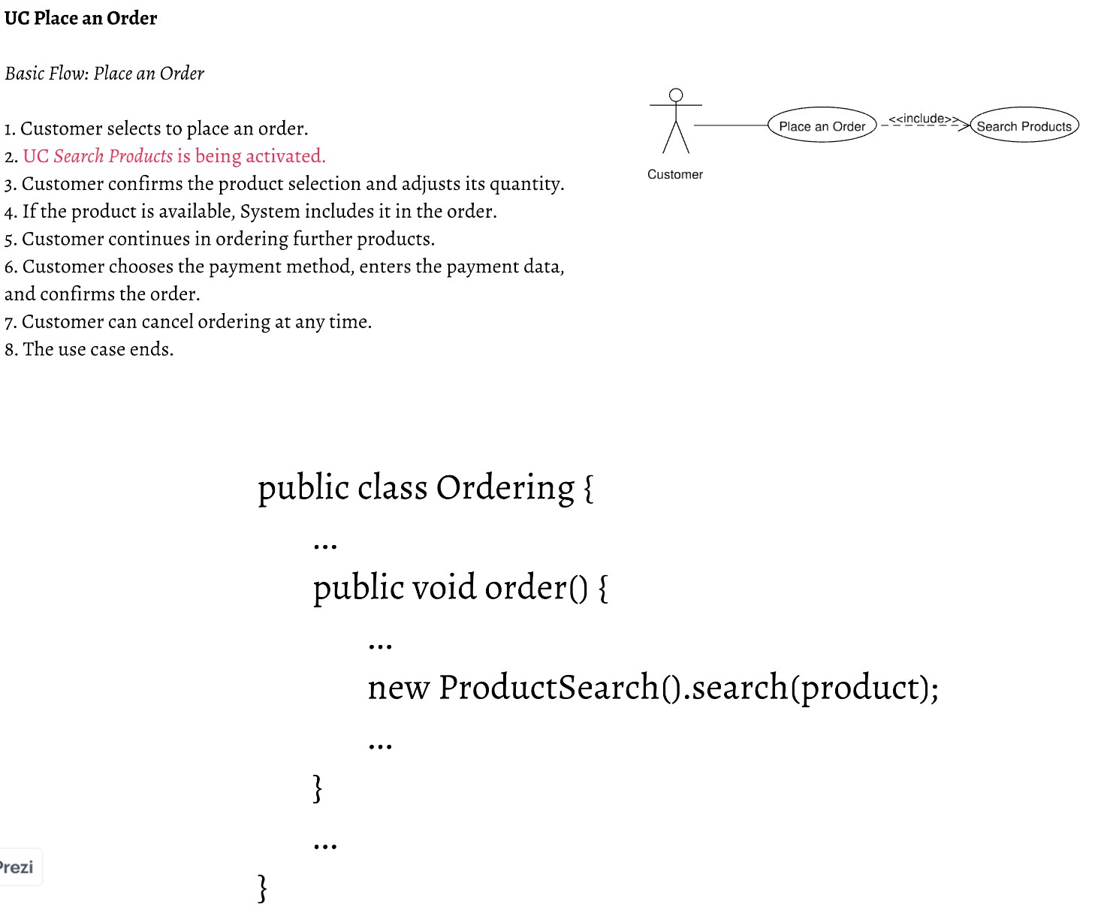
Example taken from: http://www2.fiit.stuba.sk/~vranic/

Slide 31
As concern that
do not know about
Place An Order
concern
Some kind
of weaving
Example taken from: http://www2.fiit.stuba.sk/~vranic/

Slide 32
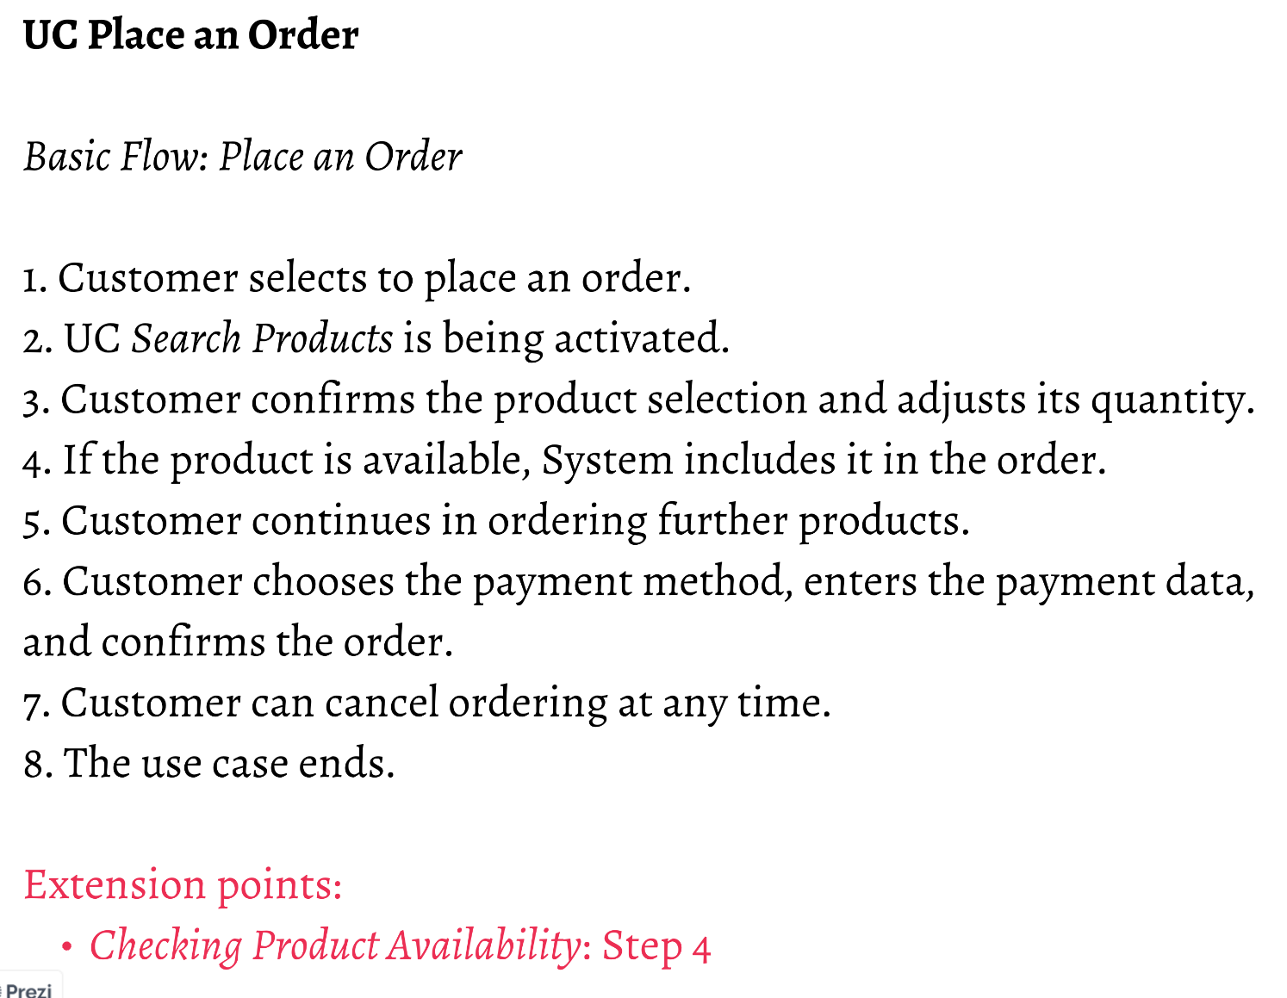
Example taken from: http://www2.fiit.stuba.sk/~vranic/

Slide 33
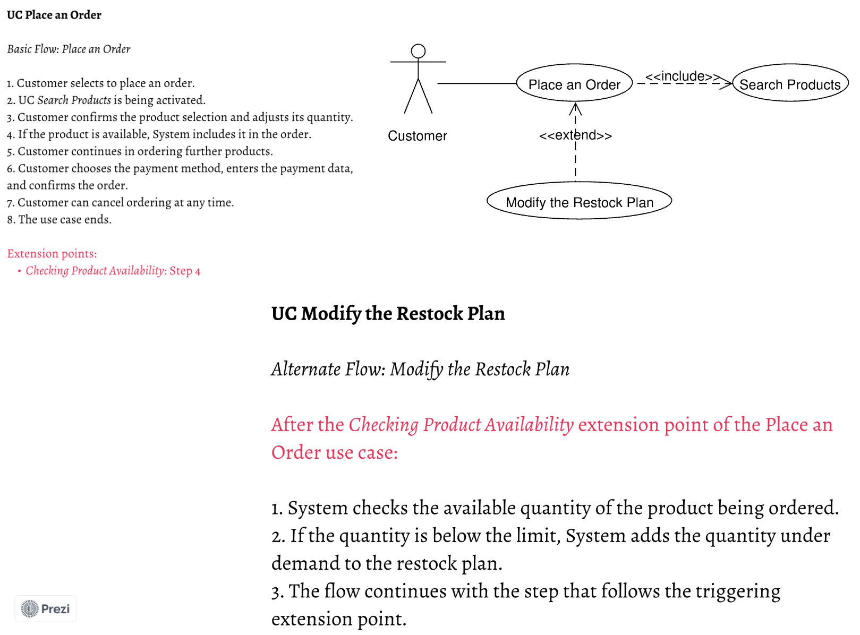
Example taken from: http://www2.fiit.stuba.sk/~vranic/

Slide 34
After Step 4:
Example taken from: http://www2.fiit.stuba.sk/~vranic/

Slide 35
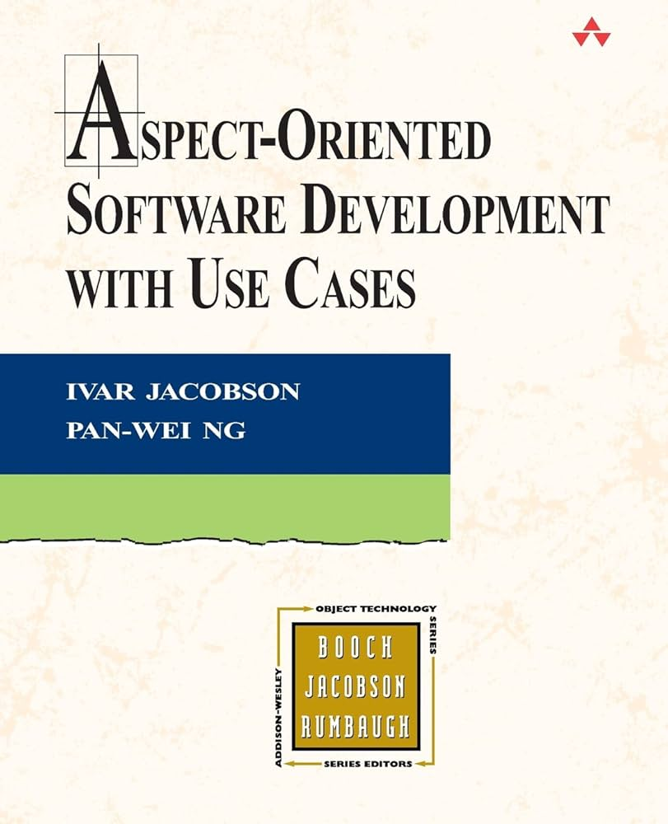
Approach to
Use-Case Modelling
Using Aspects
A refreshingly new approach toward improving use-case modeling by fortifying it with aspect orientation." -- Ramnivas Laddad, author of AspectJ in Action "Since the 1980s, use cases have been a way to bring users into software design, but translating use cases into software has been an art, at best, because user goods often don't respect code boundaries. Now that aspect-oriented programming (AOP) can express crosscutting concerns directly in code, the man who developed use cases has proposed step-by-step methods for recognizing crosscutting concerns in use cases and writing the code in separate modules. If these....
Source: https://www.google.com/url?sa=i&url=https%3A%2F%2Fwww.amazon.com%2FAspect-Oriented-Software-Development-Use-Cases%2Fdp%2F0321268881&psig=AOvVaw0VBnKKncqUKNR37gDS5eT&ust=
1726665756534000&source=images&cd=vfe&opi=89978449&ved=0CBQQjRxqFwoTCIjyj6uJyogDFQAAAAAdAAAAABAE

Slide 36
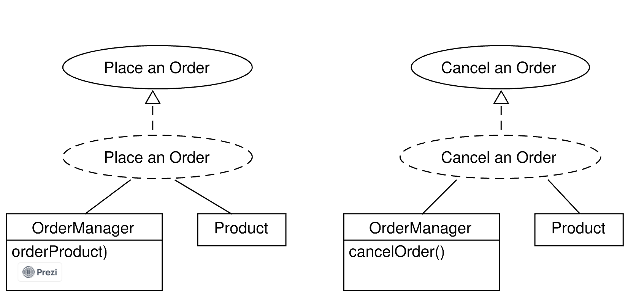

Slide 37
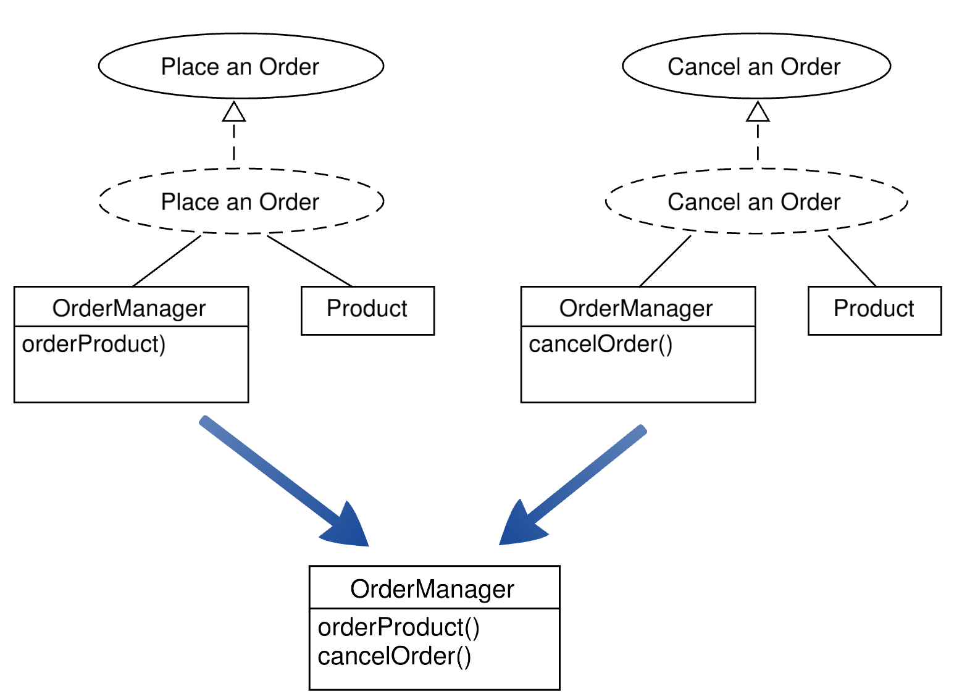

Slide 38
Symmetric AOP modularization
Whole is composed out of the
aspects at the same level:
Each aspect is different view of whole
Retail
Composition
rules
Aspect 1
Aspect 3
Composition rules
Aspect 2
Composition rules

Slide 39
Symmetric AOP modularization
Retail/order is composed out of its concerns
(create, cancel, modify,…) at the same level:
Whole
Composition
rules
Create
order
Cancel
order
Composition rules
Modify
order
Composition rules

Slide 41
Asymmetric AOP modularization
Aspect 3
Aspect 1
Whole
Affect
Affect
Preexisting
whole
With aspects
Weaving
Aspect 2
Affect
Base decomposition

Slide 42
Symmetric AOP modularization
Asymmetric AOP modularization
AspectJ
Base decomposition
Aspects
HyperJ
Whole is composed out
of different views

Slide 43
Peer use cases vs.
Extend relationship
Symmetric AOP
Entities at the same level are composed into whole
Asymmetric AOP
Basic entity is affected by special entity (aspect)

Slide 44
Dictionary of basic terms
Concern
  Specific requirement or consideration that must be addressed in order to satisfy overall system goal (Laddad 2003).
Software system
  Realization of a set of concerns (Laddad 2003).
Aspect
  New unit of modularization. Aspects crosscuts other modules.
Crosscutting concerns
  System-wide concerns (such as logging, remote management, and path optimization, etc.) that span multiple modules
Aspect weaver
  A compiler-like entity which composes the final system – combines core and crosscutting modules.
Weaving
  The process where core and crosscutting concerns are combined into the final system.
Pointcuts
  Sets of join points

Slide 45
Dictionary of basic terms
Join Point
  Any point in the system that can be executed (Laddad 2003). It can be calling a method, creating a class, accessing a variable, but also executing the condition in the code. Different languages ​​only support certain captures types, for example the developed language AspectJ works at the level of methods and fields (Lee and Kang 2004).
  Determined with pointcuts
Variation Point
  A point that identifies the places where it occurs to variations (Jacobson et al. 1997). As long as it is modeled on their basis variability, then the main components of assets consist of these points, and also of from them, components of the target system will be created using variants (Webber and Gomaa 2004). All available variants are thus supported.
Advice
  The advice is the action and decision-making part which it allows for the expression of intersecting action at the joining point (Laddad 2003). Point connection is captured by the corresponding pointcut. It is implemented as construction in the form of a method called before (before), behind (after) or wrapping (around) the specified join point.
  To express modification of original code
Pointcuts
  Selects sets of join points and collects context in their place

Slide 46
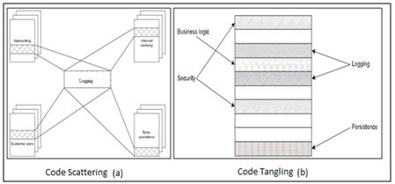
Dictionary of basic terms
Code Tangling
  Module handles multiple concerns simultaneously.
Code Scattering
  Single issue is implemented in multiple modules.
  A) Duplicated code blocks
    Repeated almost identical code
  B) Complementary code blocks
    Complementary parts of the same
    concern implemented by various modules
Taken from: Magableh, Aws & Alsobeh,
Anas. (2018). Aspect-Oriented Software Security
Development Life Cycle (AOSSDLC).
10.5121/csit.2018.81204.

Slide 47
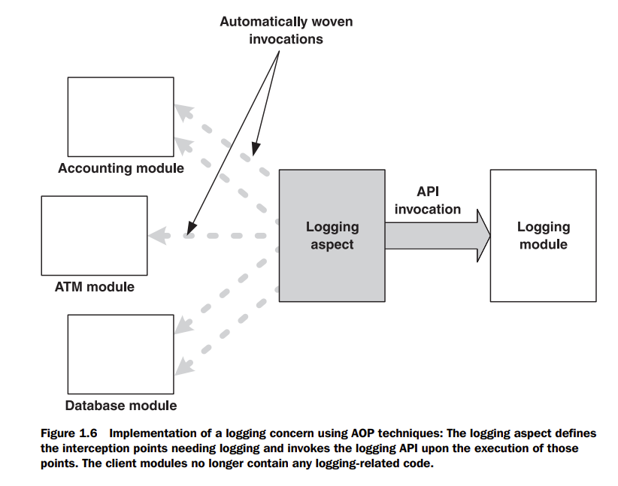
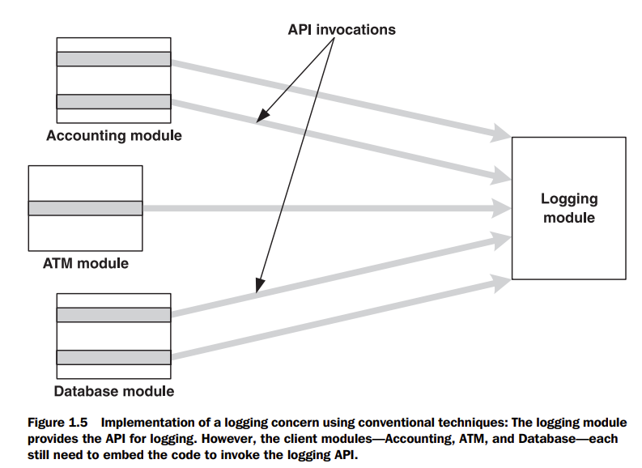
Implementation of logging concern
Taken from: LADDAD, Ramnivas, 2003. AspectJ in action: practical aspect-oriented programming.
Greenwich, CT: Manning. ISBN 978-1-930110-93-9

Slide 48
Pointcuts – different kinds
Annotation based pointcuts
Method/constructor call
Method/constructor execution
Execution object pointcuts
Control flow based pointcuts
Argument pointcuts
Initialization
Field Access
Exception Handling
Advice execution
Conditional pointcut
Pointcut based on Lexical structure

Slide 49
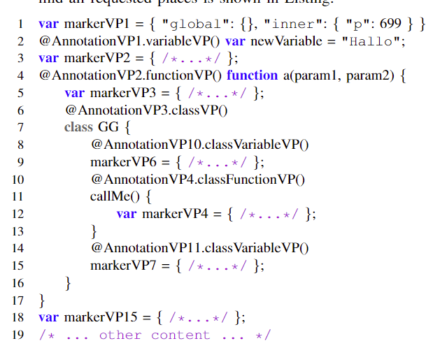
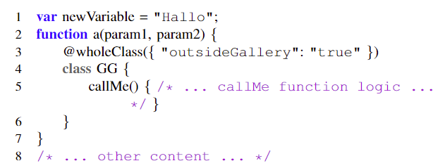
Example: Annotation based join points
Automated pointcut extraction
with semantic information

Slide 50

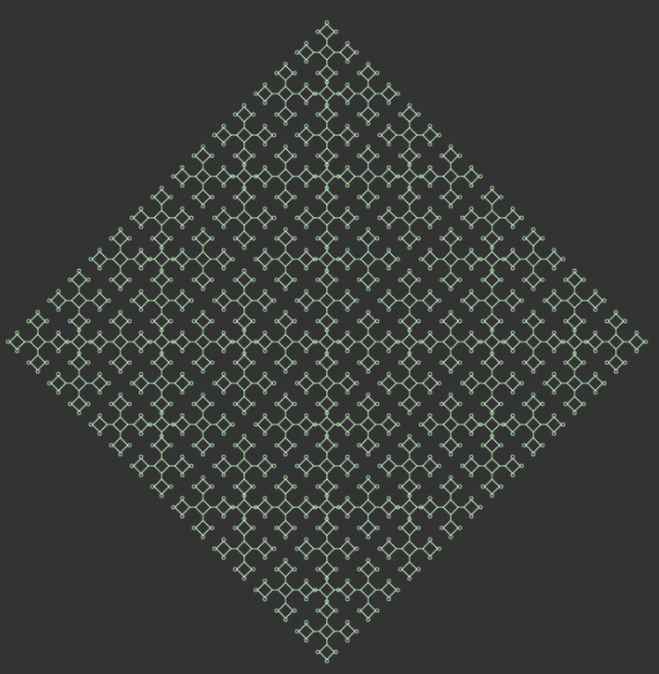
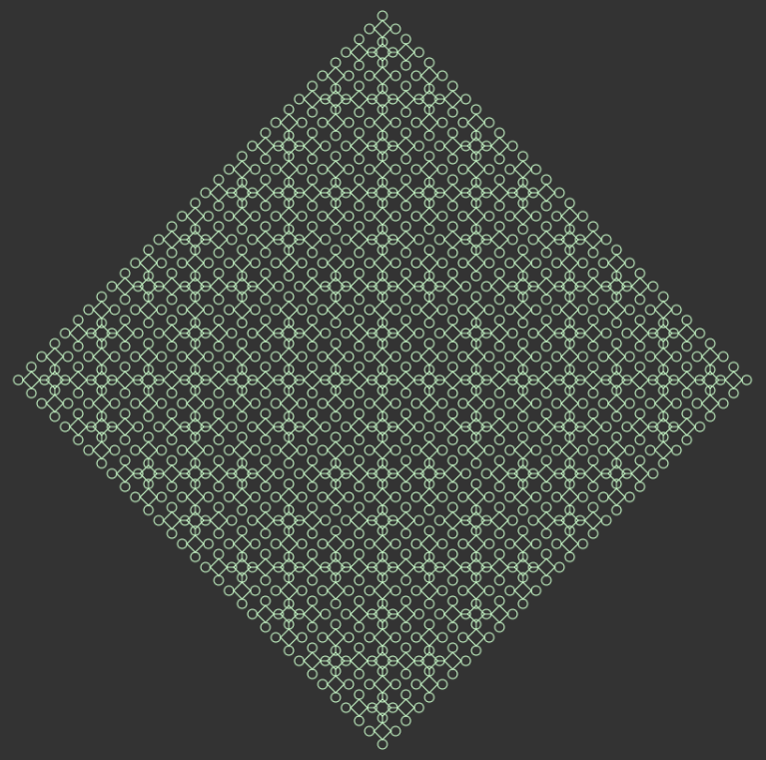
Application: Software product line for fractals

Slide 51
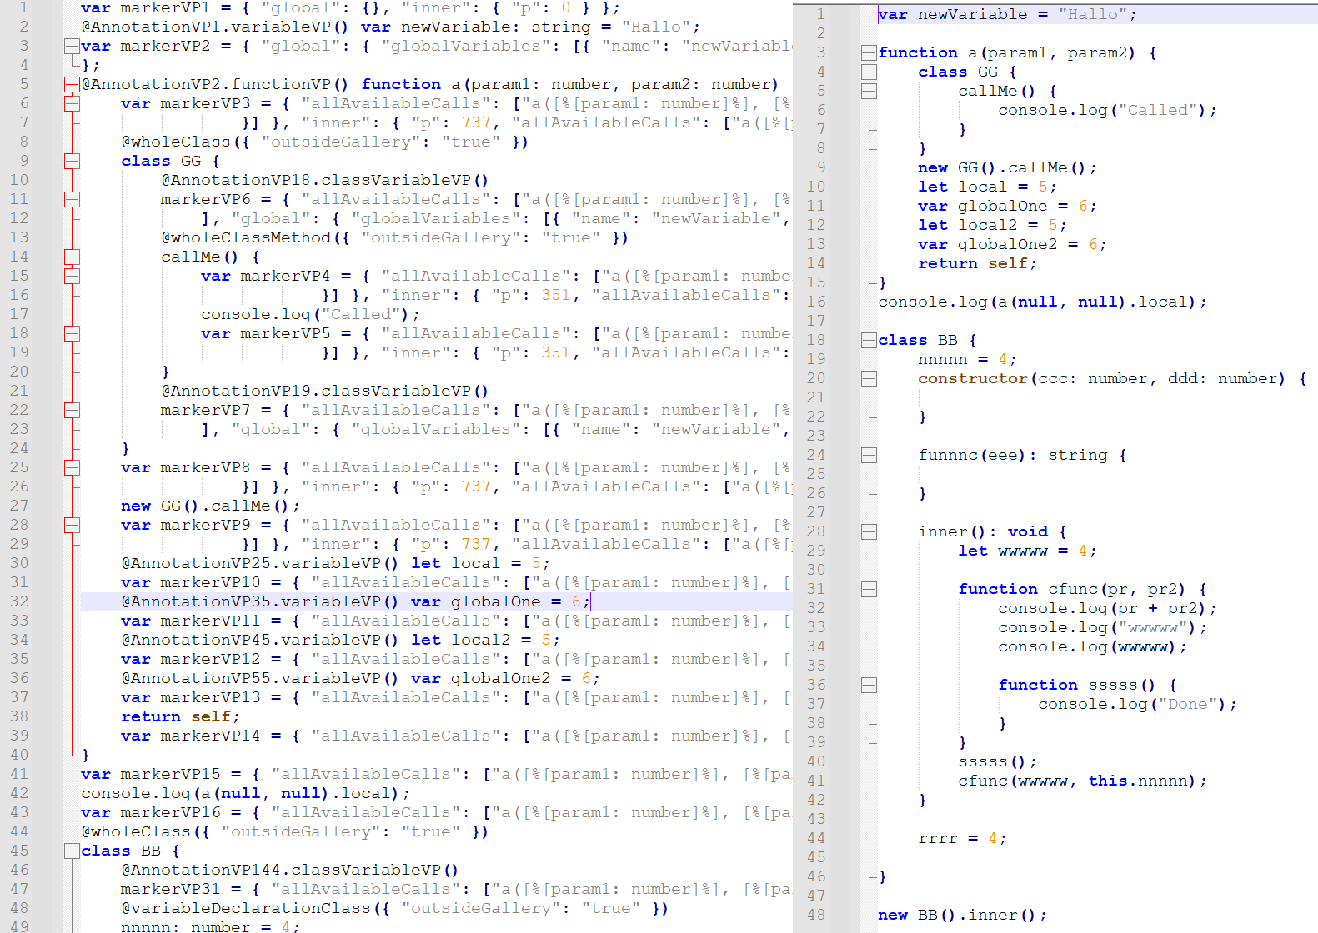

Slide 53
Dynamically extending class
1. Declaring class
Prototype-based programming
class VerticePair {
  constructor(x, y) {
    this.x = x;
    this.y = y;
  }
  getX() { return this.x; }
  getY() { return this.y; }
}
2. Instantiating class
var verticePair = new VerticePair(5, 6);
var newX = verticePair.x;
console.log(newX); //newX //(or) //to prints newX
3. Extending class dynamically
-possibly with new features… that can be then evolved independently
VerticePair.prototype.checkPoint = function() { if (this.x > 2) { throw new Error('Coordinate X is greater!');} }
4. Using the extension
verticePair.checkPoint();

Slide 54
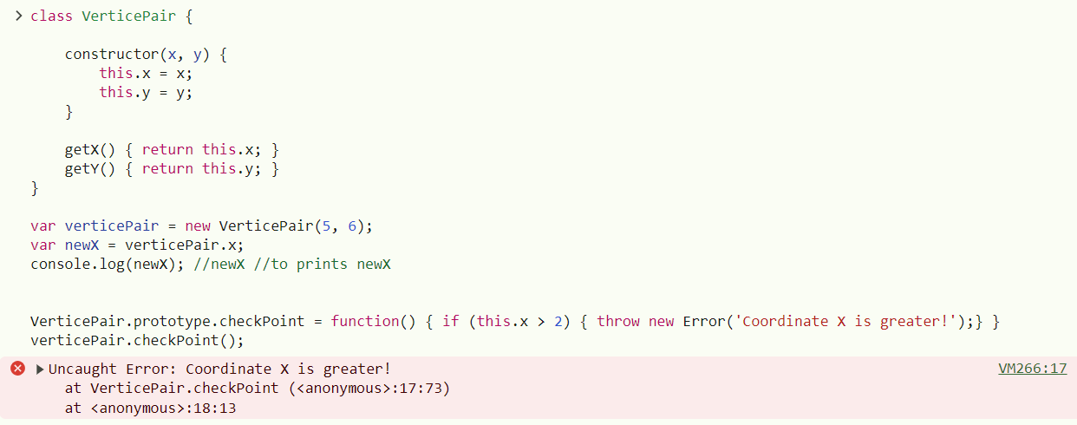
Test

Slide 55
Dynamically extending object
1. Declaring class
Dynamic Object Modification
2. Instantiating class
class VerticePair {
  constructor(x, y) {
    this.x = x;
    this.y = y;
  }
  getX() { return this.x; }
  getY() { return this.y; }
}
var verticePair = new VerticePair(5, 6);
var newX = verticePair.x;
console.log(newX); //newX //(or) //to print newX
var verticePair0 = new VerticePair(1, 6);
3. Extending class dynamically
-possibly with new features… that can be then evolved independently
verticePair.checkPoint = function() { if (this.x > 2) { throw new Error('Coordinate X is greater!');} }
4. Using the extension
verticePair0.checkPoint();
Is it successfull? Is extension bound to particular object?
verticePair.checkPoint();

Slide 56
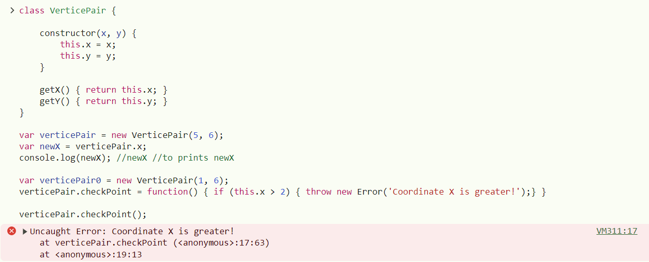
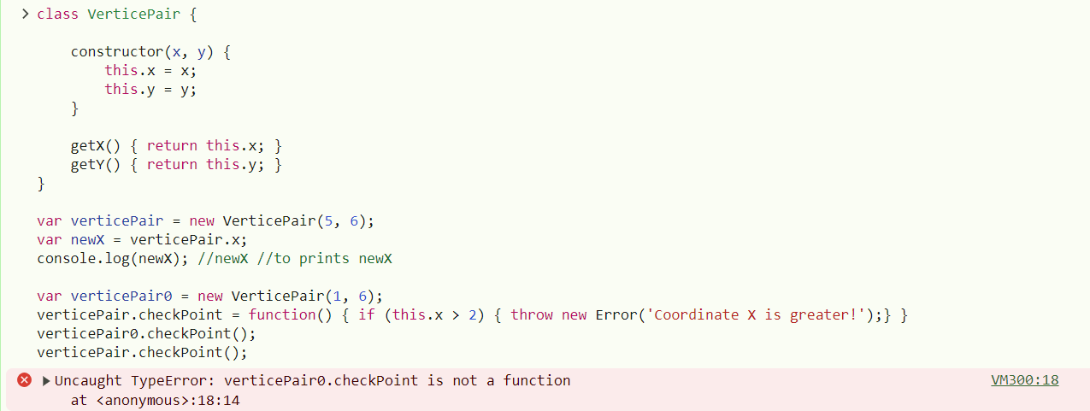
Test

Slide 57
AspectJ Basics

Slide 58
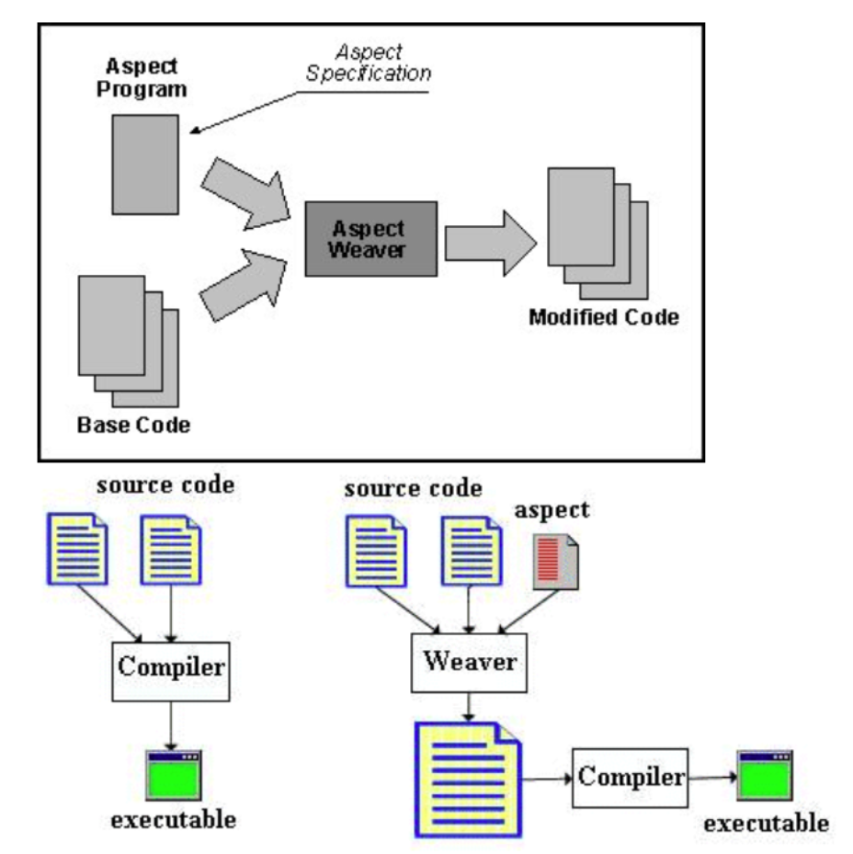
Weaving
Source: https://sites.google.com/site/sites/system/errors/
WebspaceNotFound?path=%2Fjavatouch%2Fintroduction
toaop

Slide 59
Advice
  - The advice is the action and decision-making part which it allows for the
  expression of intersecting action at the joining point (Laddad 2003).
  Point connection is captured by the corresponding pointcut. It is implemented
  as construction in the form of a method called before (before), behind (after)
  or wrapping (around) the specified join point.
  - To express modification of original code
Player around(): myPointcut {
  Scanner reader = InputReader.getReader();
  System.out.println("Set player name:");
  String playerNameLine = reader.nextLine().replace("\n", "");
  Player createdPlayer = proceed();
  createdPlayer.setName(playerNameLine);
  System.out.println(createdPlayer.getName());
  return createdPlayer;
}

Slide 60
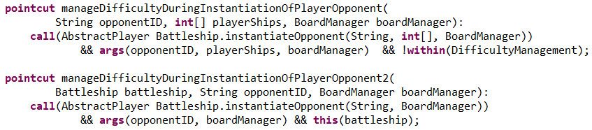
Pointcut
-selects sets of join points and collects context in their place
Example
To capture constructor call, when Player instance is going to be created
call(Player.new(..))
To check condition (for example for variability handling)
To capture constructor call, when Player instance is going to be created,
but setNames from Configuration has to be true
call(Player.new(..)) && if(Configuration.setNames);
Complex examples with whole declaration (within aspect):

Slide 61
Pointcut language
call(Player.new(..))
Any number, name, and type of arguments
Player class
is called
To capture
constructor
execution(Player.new(String))
Player class
is executed
To capture
constructor
With one argument from which the first one has type String

Slide 62
Introduction
-a static crosscutting instruction
-to introduce relation such as specialization
Example [USED FOR EXAMPLE JUST TO MARK SOME
CLASSES FOR FURTHER PROCESSING]:
declare parents: Human implements taxDodger;

Slide 63
Compile-time declaration
-a static crosscutting instruction
-to introduce compile time warnings and errors to warn or prevent
some unwanted development practices
Example [TO PREVENT AND CHECK UNWANTED DEVELOPING PRACTICES]:
-a compiler warns when any of System.print or System.println method is used
declare warning: call(void System.out.print*(..)) :
“Do not output directly to the console. Use logger instead!";

Slide 64
Example: Intertype declaration in AspectJ
Extends Player class with variable
called name with String type
public aspect PlayerName {
private String Player.name;
private void Player.setName(String playerName) {
  this.name = playerName;
}
private String Player.getName() {
  return this.name;
}
Extends Player class with function
setName(String playerName)
Extends Player class with function
getName()
Possibly to set up functionality additively and incrementally,
only empty classes that will be extended are required.
}

Slide 66
Example: Aspect in AspectJ
public aspect PlayerName {
Player around(): call(Player.new(..)) && if(Configuration.setNames){
  Scanner reader = InputReader.getReader();
  System.out.println("Set player name:");
  String playerNameLine = reader.nextLine().replace("\n", "");
  Player createdPlayer = proceed();
  createdPlayer.setName(playerNameLine);
  System.out.println(createdPlayer.getName());
  return createdPlayer;
}
}

Slide 67
How to run AspectJ?
Download Eclipse 2024 - 06: -> https://www.eclipse.org/downloads/packages/release/2024-06/r -> Eclipse IDE for Java Developers 328 MB
If it is ZIP unpack it to directory: C:\Users\{profile}\eclipse\java-2024-06, otherwise follow instalation steps
Launch eclipse.exe positioned in above directory
In menu Help -> Eclipse marketplace ->AJDT -> install
In menu File -> new Project -> Other -> AspectJ -> AspectJ Project
Compatibility information: https://marketplace.eclipse.org/content/aspectj-development-tools

Slide 68
The Complexity of Asymmetric Aspect Oriented Programming
In its pointcut language.

Slide 69
Aspect-Oriented
Programming is Quantification And Obliviousness.
R. E. Filman and D. P. Friedman, 2000

Slide 70
Use of Aspects in Software Product Lines

Slide 71
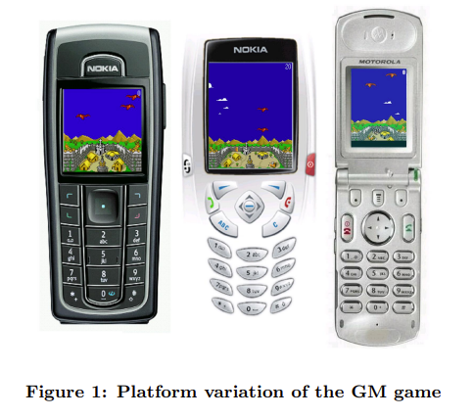
Aspect-Oriented
Product Line
An Incremental Aspect-Oriented Product Line Method for J2ME Game Development
exploring the platform variation arising due to use of proprietary API and limited memory. In particular, we consider three platforms (PA, PB, and PC ) on which the same game GM is run.
  PA relies solely on MIDP 1.0,
  whereas PB and PC rely on MIDP 1.0 and proprietary API.
  Further, PC constrains bytecode size to half of the other platforms.
Source: Alves, V., Jr, P.M., Borba, P.: An Incremental Aspect-Oriented
ProductLine Method for J2ME Game Development p. 3 (Jan 2004)

Slide 72
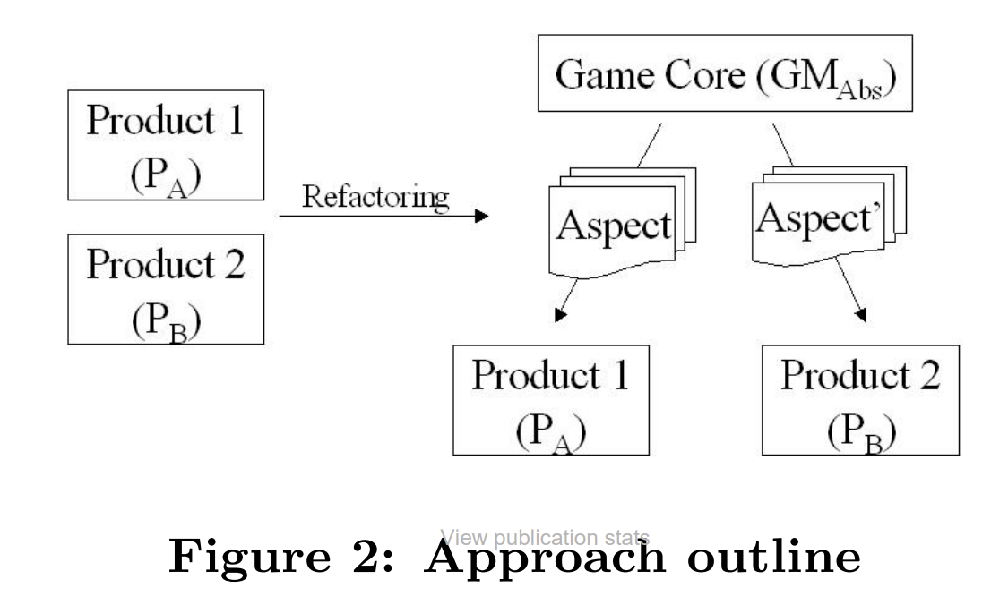
Approach
The goal is to structure a product line around GM so that it can be easily configured for any of the platforms PA, PB, or PC . The outline of our approach is as follows. First, given GM in PA and PB, we identify variation points, refactor code to encapsulate these points, and extract the specialized behavior into AspectJ aspects. The outcome is an aspect for introducing the specifics of each of these two platforms and an abstract GM, which we refer to as GMAbs. Next, the resulting product line is considered with the remaining product, and we reapply the previously described procedure. The result is a new product line encompassing all three products.
Source: Alves, V., Jr, P.M., Borba, P.: An Incremental Aspect-Oriented
ProductLine Method for J2ME Game Development p. 3 (Jan 2004)

Slide 73
Improving Reusability
Has to be variable enough
Using the same functionality in different context
Assets
Reusability in different products
Increase in size and complexity
of software systems
  Need for effective modularity
  Need for effective abstraction mechanisms
  Need for effective composition mechanisms
SUPPORTING VARIABILITY
– as attribute of modern development practices
Automatization of
software
development
Software product lines
Generative programming
Speeding up
time to market
Highly reusable software components and libraries

Slide 74
Software Product Lines
A software product line is a set of software-intensive systems sharing a common, managed set of features that satisfy the specific needs of a particular market segment or mission and that are developed from a common set of core assets in a prescribed way
Systematically managing variability in a set
of software products
Identifikácia variantov
Produced and reused in quantity of products
= product family
Identifikácia výrazov obsahujúcich vnútorné vzťahy
PRODUCT FAMILY
Core Assets
medzi variantmi
Documents, models, portfolios, project plans, architecture, design models, but primarily software components.
variantov s core aktívami
benefity

Slide 75
New Dimension in Software: Variability
Software product lines as complex software intensive systems
Increased complexity:
-evolution of common assets
-independent evolution of products and their instantiation
Independent on structure, behaviour, and its state
- problem with modularization
Modularizing different kinds of variability
Preserving encapsulation and communication over explicit interfaced

Slide 76
Feature-Oriented Decomposition
Analysis only of those modules of the features that are available in product
Design benefits
- Independent evolution of product line features
- Modular introduction of new features
- Does not always reflect on technical commonalities between features
Does not rely on one-to-one correspondence of
features from feature model and features describing
variations in software product line
and implementation modules
Taken from: Rashid, A., Royer, J.C., Rummler, A. (eds.):
Aspect-Oriented, Model-Driven Software Product Lines:
The AMPLE Way (09 2011)

Slide 77
Views on Software Product Line Development
Clements & Krueger, 2002
Reactive/extractive software product line engineering
Proactive
software product line engineering
Accumulation of investition in form of as much high reuse of functionality from existing products as possible
Forward design and engineering investition to point where enough products are geenrated
Neet to support generalization of reusable assets from specific products by systematic refactoring
Architectonical refactoring
Development technology

Slide 78
Problems with repeatable benefiting from software product lines
Awais Rashid, Jean-Claude Royer and Andreas Rummler 2011
1. Challenge with scaling
3. Focus on various business contexts
2. Systematicity of variations
HIGH NUMBER OF VARIANTS
Each with own complexity
V ktorej majú tendenciu ovplyvňovať architektúru celého radu softvérových výrobkov
Exponential increase of inner dependencies and mutual relations
Problem to comprehend interactions between variants
(from requirements to implementation)
Tackled by AMPLE project

Slide 79
Product Line Engineering (PLE)
Výrobok (product)
Expressing model in PLE context
Platforma (platform)
Vlastnosť (feature)
Set of components that are reused during the development
(regardless of the narrowness of their integration)
-combines and manages all available artifacts (for product creation)
-serves as technological basis
Differentiates the products from each other
shares
Is differentiated by
User can see it
COMMON CHARACTERISTICS (COMMONALITIES)
VARIABLE CHARACTERISTICS (VARIABILITY)
Managed in PLE (within platform)
Product derivation (derivation)
Process of product creation
User-visible aspect
A set of core artifacts
Usually
Semi-automatically
Products created on top of core artifacts
Technológie umožňujú jeho plnú automatizáciu
Set of technologies for product derivation

Slide 80
Features
Configuration
Variačný bod (Variation Point)
Varianty (Variants)
A choice amongst multiple options during the management of variable features by the platform
Characteristics exposed by a platform and modified into some extent
Formed when variation point is bound to specific value
Features
(vlastnosti)
Independent features
Mutually exclusive features
Dependent features on incorporation of another feature
Features with relations to other features

Slide 81
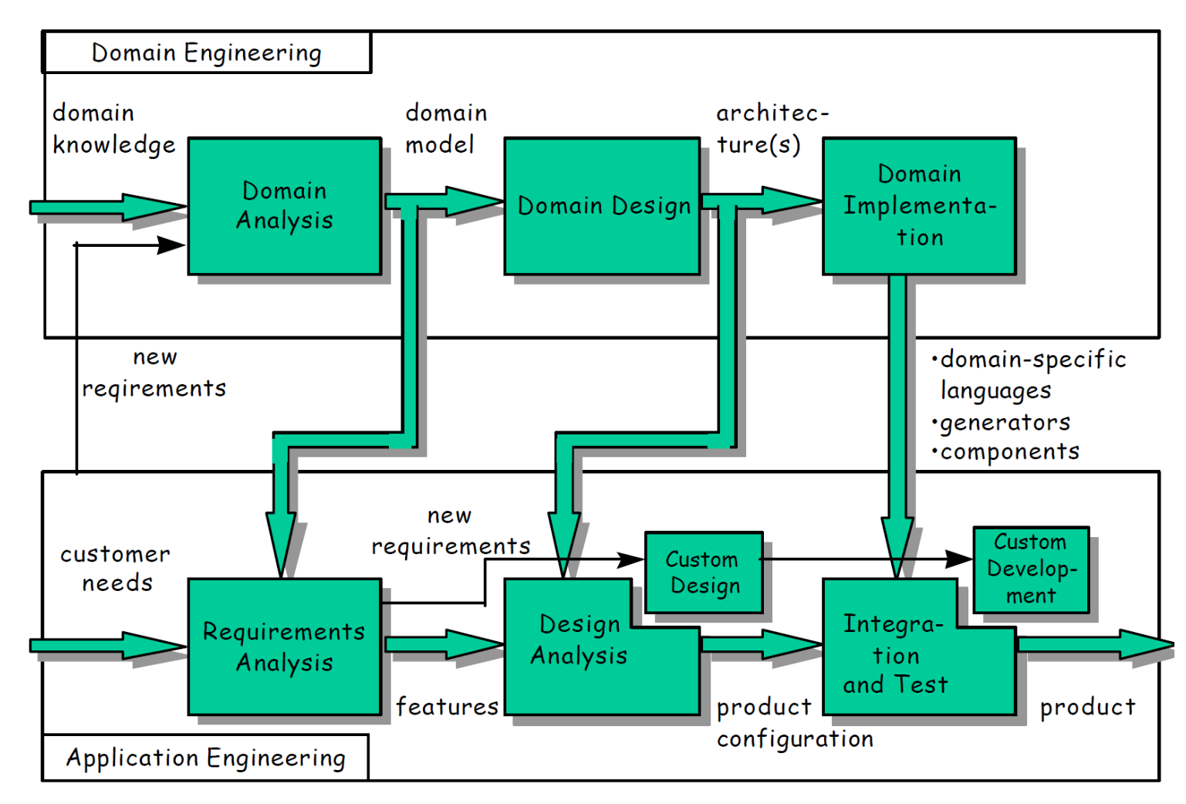
Domain engineering
Development of components - For reuse
Introduction of platform
including all associated activities
Defining common and variable features
Creating the components responsible for variability management
Creation of tools for differentiating and tracing of variability (tools and methods of reusable components management)
Defining the range in which products can be constructed
Application engineering
Product instantiation - With reuse
Creation of product/products
Software product lines and domain engineering:
K. Czarnecki. Generative Programming: Principles and Techniques
of Software Engineering Based on Automated Configuration and
Fragment-Based Component Models. Ph.D. Thesis,
Deriving products with help of tools from previous phase
Customization of existing product: creating application specific components for one particular product
Rashid, A., Royer, J., & Rummler, A. (Eds.). (2011). Aspect-Oriented, Model-Driven
Software Product Lines: The AMPLE Way. Cambridge: Cambridge
University Press. doi:10.1017/CBO9781139003629

Slide 82
NEWLY REQUESTED FEATURE
Provided by components to increase reuse
Candidate for introducing the platform
Domain engineering
Application engineering
MULTIPLE PREDICTABLE FEATURES
Both phases run in parallel
Designing the platform to support application engineering
Reusable templates, elements (models, documentation, source code,…), and parts usable in application engineering
Other artifacts are on output
Uses templates and elements during the creation of resulting products
IT IS NOT ABOUT COLLECTING ELEMENTS IN REPOSITORIES AIMING TO REUSE THEM
Variability modelling
Need to describe variability
-available components
-variable characteristics of components
-differentiating/managing variability
Difference in comparison with software engineering of one product
Feature models

Slide 83
ECaesarJ – Evolving Software Product Lines

Slide 84
Modularization of Static Structures
1. No replacement of classes in inheritance relationship.
-redeclaration of inheritance relationship
between classes
MULTIPLE INHERITANCE
Impossible in Java
- introduction of additional glue code (for example in C++)
2. Incorporation of planned functionality (domain knowledge)
INVASIVE CHANGES OTHERWISE
If open-closed principle cannot be used = implementation of core features has to be changed
                during introduction of product-specific feature
3. Instantiation of extended classes instead of original ones
REDEFINITION IN ALL PLACES WHERE
EXTENDED CLASS IS INSTANTIATED
Here:

Slide 85
Handling Event Using Observer Design Pattern
Modularization of behaviour
1. Much glue code – registration and notification of observers
2. Incorporation of planned functionality (domain knowledge)
INVASIVE CHANGES OTHERWISE
If open-closed principle cannot be used = implementation of core features has to be changed
                during introduction of product-specific feature
3. No support of declarative definition of events
Difficult to reuse for defining
other kind of events
EXPLICIT TRIGGERING IS NECESSARY

Slide 86
Quality of Applying Voluntary Features Using AspectJ
More complex AspectJ solution in some case
2x as long
PROBLEMS
Redundant use of parameters in AspectJ pointcuts
Scope problem
Need of using state extension
Variables can be accessed by priviledged aspects
Use hook methods to extend context
Inability to create own exception for new Aspects
Use of dynamic exceptions is required

Slide 87
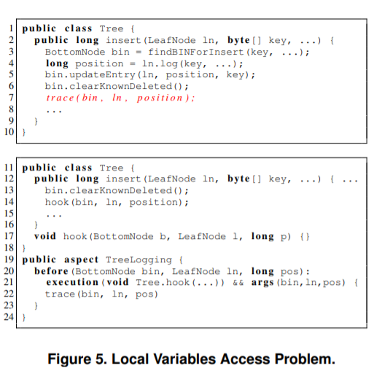
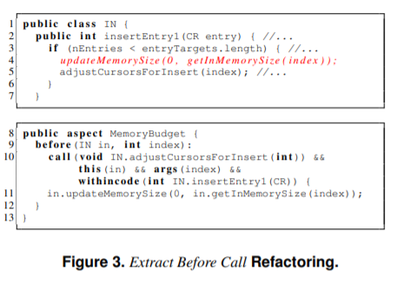

Slide 88
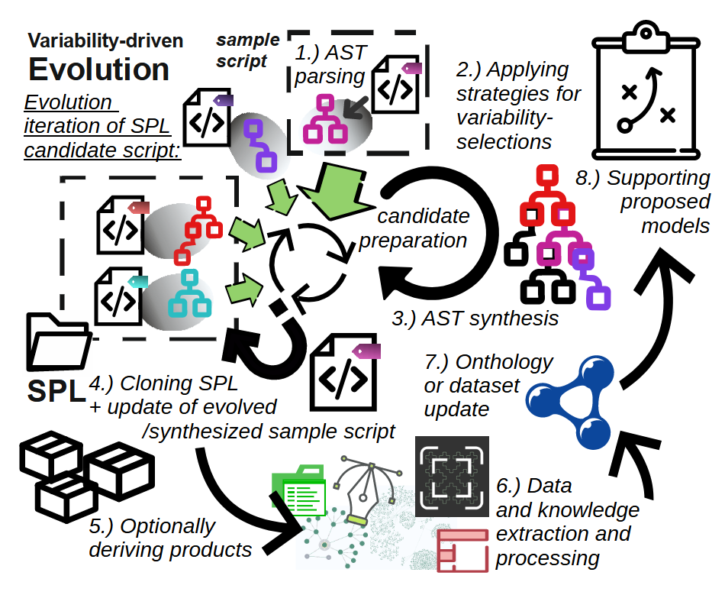
Our
Approach

Slide 89
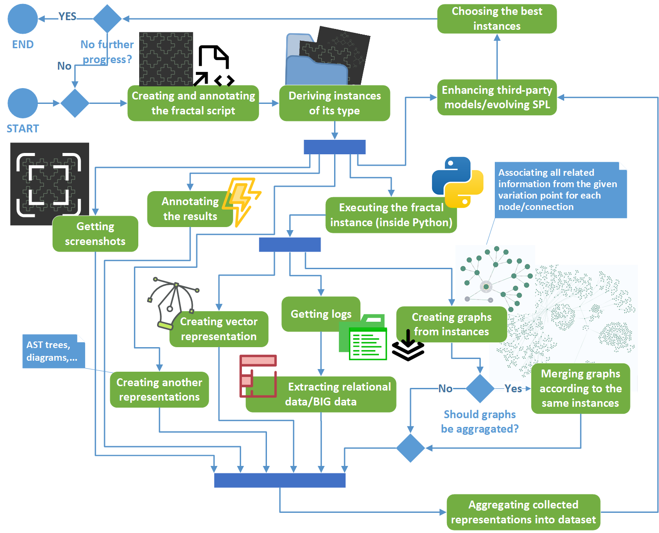

Slide 90
References
CaesarJ: https://caesarj.org/
Product Line Implementation with ECaesarJ: Rashid, A., Royer, J.C., Rummler, A. (eds.): Aspect-Oriented, Model-Driven Software Product Lines: The AMPLE Way (09 2011)
Aspect-oriended recreation of design patterns, application of patterns: R. Miles, AspectJ cookbook, 1st ed. Sebastopol, CA; Farnham: O’Reilly Media, 2004.
Aspect-oriented recreation of Observer design pattern: E. Piveta and L. Zancanella, “Observer pattern using aspect-oriented programming,” Proceedings of the Third Latin American Conference on Pattern Languages of Programming, p. 12, 12 2003
Complexity of In-code Variability - Evaluating Complexity of Cariability Management Constructs: Perdek, Jakub, and Valentino, Vranić. "Complexity of In-Code Variability: Emergence of Detachable Decorators.", In Reuse and Software Quality (pp. 51–71). Springer Nature Switzerland, 2024.
Framed Aspects: Loughran, N., Rashid, A.: Framed aspects: Supporting variability and configurability for AOP. In: Proceedings of 8th International Conference on Software Reuse, ICSR 2004. LCNS 3107, Springer, Madrid, Spain (2004)

Slide 91
References
Supporting Product Line Evolution With Framed Aspect: Loughran, N., Rashid, A., Zhang, W., Jarzabek, S.: Supporting product line evolution with framed aspects p. 5 (2004)
YOUNG, Trevor J a B MATH, 1999. Using AspectJ to Build a Software Product Line for Mobile Devices. 1999, s. 73.
ZHANG, Tao, Lei DENG, Jian WU, Qiaoming ZHOU a Chunyan MA, 2008. Some Metrics for Accessing Quality of Product Line Architecture. V: 2008 International Conference on Computer Science and Software Engineering: 2008 International Conference on Computer Science and Software Engineering [online]. Wuhan, China: IEEE, s. 500–503. ISBN 978-0-7695-3336-0. Dostupné na: doi:10.1109/CSSE.2008.500
FILMAN, Robert E a Daniel P FRIEDMAN. Aspect-Oriented Programming is Quantification and Obliviousness. 2001.
Hallsteinsen, S., Hinchey, M., Park, S., Schmid, K.: Dynamic software product lines. IEEE Computer 41, 93–95 (01 2008). Paper
Alves, V., Jr, P.M., Borba, P.: An Incremental Aspect-Oriented Product Line Method for J2ME Game Development p. 3 (Jan 2004)

Slide 92
Zlepšenie znovupoužiteľnosti
Musia byť dostatočne
variabilné
Použitia tej istej funkcionality v inom kontexte
Aktíva
Znovupoužiteľnosť v iných produktoch
Nárast komplexnosti a veľkosti systémov
  potreba efektívnej modulárnosti
  potreba efektívnych mechanizmov abstrakcie
  potreba efektívnych kompozičných mechanizmov
PODPORA VARIABILITY
– ako atribút moderných praktík vývoja
automatizácia
softvérového
vývoja
Rady softvérových výrobkov
Generatívne programovanie
Vysoko znovupoužiteľné knižnice a komponenty
Urýchlenie času predaja
– time to market

Slide 93
Rady softvérových výrobkov
A software product line is a set of software-intensive systems sharing a common, managed set of features that satisfy the specific needs of a particular market segment or mission and that are developed from a common set of core assets in a prescribed way
Systematické manažovanie variability
v súprave produktov
Identifikácia variantov
Produkované a znovupoužívané
v množstve produktov
= rodine produktov
Identifikácia výrazov obsahujúcich vnútorné vzťahy
RODINA PRODUKTOV
Core aktíva
medzi variantmi
Dokumenty, modely, portfóliá, projektové plány, architektúra, návrhové modely, a hlavne komponenty.
variantov s core aktívami
benefity

Slide 94
Pohľady na vývoj radov softvérových výrobkov
Clements & Krueger, 2002
Reaktívne/extraktívne inžinierstvo radov softvérových výrobkov
Proaktívne inžinierstvo radov softvérových výrobkov
Akumulácia investícií v podobe čo najväčšieho znovupoužitia súčastí/funkcionality z existujúcich výrobkov
Dopredný návrh a inžinierska investícia do bodu keď sa vygeneruje dostatočné množstvo výrobkov
Potreba podpory zovšeobecnenia znovupoužiteľných aktív z konkrétnych výrobkov systematickým refaktorovaním
Architektonický refaktoring
Vývojová technológia

Slide 95
Problémy v opakovanom benefitovaní z radov softvérových výrobkov
Awais Rashid, Jean-Claude Royer and Andreas Rummler 2011
1. Výzva so škálovaním
3. Zameranie sa na rozličné biznis kontexty
2. Systematickosť variácií
VYSOKÝ POČET VARIANTOV
Každý s vlastnou zložitosťou
V ktorej majú tendenciu ovplyvňovať architektúru celého radu softvérových výrobkov
Exponenciálny nárast vnútorných závislostí a vzájomných vzťahov
Problém pochopiť interakcie medzi variantmi
(od požiadaviek k implementácii)
Riešené v AMPLE projekte

Slide 96
Inžinierstvo radov softvérových výrobkov
Výrobok (product)
Product line engineering
(PLE)
Označenie modelu v kontexte PLE
Platforma (platform)
Množina komponentov znovupoužitých počas vývoja
(bez ohľadu na úzkosť ich integrácie)
-kombinuje a manažuje všetky dostupné artefakty (pre vytvorenie výrobku)
-slúži ako technologická základňa
Vlastnosť (feature)
Odlíšenie výrobkov jeden od druhého
Zdieľa
Je rozlíšený
Istým spôsobom viditeľná/rozlíšiteľná používateľom
SPOLOČNÉ CHARAKTERISTIKY (COMMONALITIES)
ROZDIELNE CHARAKTERISTIKY (VARIABILITY)
Manažované PLE (v rámci platformy)
Odvodenie výrobkov (derivation)
Proces tvorby produktov
User-visible aspect
Množina core artefaktov
Zvyčajne
Semi-automaticky
Výrobky vytvárané
na vrchu core artefaktov
Technológie umožňujú jeho plnú automatizáciu
Množina technológií pre odvodenie výrobkov

Slide 97
Vlastnosti (features)
Konfigurácia
Variačný bod (Variation Point)
Varianty (Variants)
Výber medzi viacerými možnosťami pri manažovaní variabilných vlastností platformou
Charakteristika vystavená/
exponovaná platformou a pozmeniteľná do istej miery
Formované keď variačný bod sa naviaže s istou hodnotou
Vlastnosti
(features)
Navzájom nezávislé vlastnosti
Vzájomne sa vylučujúce vlastnosti
Vyžadujúce zahrnutie inej vlastnosti
Majúce vzťahy s inými vlastnosťami

Slide 98
Doménové inžinierstvo
Development of components - For reuse
Proces zavedenia platformy
vrátane všetkých pridružených aktivít
Definovanie spoločných a rozdielnych čŕt
Tvorba komponentov zodpovedných za manažovanie variability
Tvorba nástrojov pre rozlíšenie a namapovanie variability (nástroje a metódy manažmentu znovupoužiteľných komponentov)
Definovanie rozsahu v akom môžu byť produkty konštruované
Aplikačné inžinierstvo
Product instantiation - With reuse
Tvorba produktu/produktov
Software product lines and domain engineering:
K. Czarnecki. Generative Programming: Principles and Techniques
of Software Engineering Based on Automated Configuration and
Fragment-Based Component Models. Ph.D. Thesis,
Odvodenie produktov za pomoci nástrojov z predchádzajúcej fázy
Kustomizácia existujúceho výrobku: tvorba aplikačno-špecifických komponentov v rámci
iba jedného výrobku
Rashid, A., Royer, J., & Rummler, A. (Eds.). (2011). Aspect-Oriented, Model-Driven
Software Product Lines: The AMPLE Way. Cambridge: Cambridge
University Press. doi:10.1017/CBO9781139003629

Slide 99
NOVO-VYŽIADANÁ VLASTNOSŤ
Poskytnutie komponentmi pre zvýšenie úrovne znovupoužitia
Kandidát na zavedenie do platformy
Doménové inžinierstvo
Aplikačné inžinierstvo
Obe fázy bežia paralelne
VIACERÉ PREDVÍDATEĽNÉ VLASTNOSTI
Návrh platformy pre podporu aplikačného inžinierstva
Znovupoužiteľné šablóny, elementy (modely, dokumentácia, zdrojový kód,...) , a časti použiteľné v aplikačnom inžinierstve
Výstupom sú iné artefakty
Využíva šablóny a elementy pri tvorbe výsledných produktov
NIE JE TO O ZBIERANÍ ELEMENTOV V REPOZITÁROCH S CIEĽOM ICH ZNOVUPOUŽIŤ
Modelovanie variability
Nutný popis variability
-dostupných komponentov
-variabilné charakteristiky komponentov
-rozlíšenie/manažovanie variability
Rozdiel oproti bežnému softvérovému inžinierstvu jedného výrobku
Modely vlastností

